Slide 1

Clostridium difficile (CDI) Infections Toolkit
Activity C: ELC Prevention Collaboratives
Carolyn Gould, MD MSCR
Cliff McDonald, MD, FACP
Division of Healthcare Quality Promotion
Centers for Disease Control and Prevention
Draft - 12/23/09 --- Disclaimer: The findings and conclusions in this presentation are those of the authors and do not necessarily represent the official position of the Centers for Disease Control and Prevention.

Slide 2
Outline
Background
  Impact
  HHS Prevention Targets
  Pathogenesis
  Epidemiology
Prevention Strategies
  Core
  Supplemental
Measurement
  Process
  Outcome
Tools for Implementation/Resources/References

Slide 3
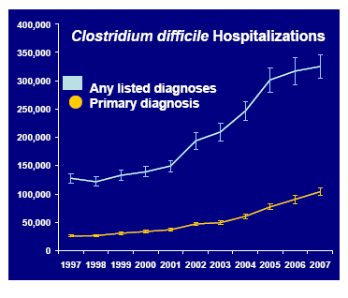
Background: Impact
Hospital-acquired, hospital-onset: 165,000 cases, $1.3 billion in excess costs, and 9,000 deaths annually
Hospital-acquired, post-discharge (up to 4 weeks): 50,000 cases, $0.3 billion in excess costs, and 3,000 deaths annually
Nursing home-onset: 263,000 cases, $2.2 billion in excess costs, and 16,500 deaths annually
Campbell et al. Infect Control Hosp Epidemiol. 2009:30:523-33. Dubberke et al. Emerg Infect Dis. 2008;14:1031-8.
Dubberke et al. Clin Infect Dis. 2008;46:497-504. Elixhauser et al. HCUP Statistical Brief #50. 2008.

Slide 4
Background: Impact
Age-Adjusted Death Rate* for
Enterocolitis Due to C. difficile, 1999–2006
2.5
Male
Female
2.0
White
Black
Entire US population
1.5
Rate
1.0
0.5
0
1999
2000
2001
2002
2003
2004
2005
2006
Year
*Per 100,000 US standard population
Heron et al. Natl Vital Stat Rep 2009;57(14).
Available at http://www.cdc.gov/nchs/data/nvsr/nvsr57/nvsr57_14.pdf
Notes:
The figure above shows the age-adjusted death rate for enterocolitis due to Clostridium difficile for 1999 through 2006, by sex and white or black race. From 1999 to 2006, the rate for this disease increased an average of approximately 30% per year for both men and women and the white and black populations.

Slide 5
Background: HHS Prevention Targets
Case rate per 10,000 patient-days as measured in NHSN
  National 5-Year Prevention Target: 30% reduction
Because little baseline infection data exists, administrative data for ICD-9-CM coded C. difficile hospital discharges is also tracked
  National 5-Year Prevention Target: 30% reduction
http://www.hhs.gov/ophs/initiatives/hai/prevtargets.html

Slide 6
Background: Pathogenesis of CDI
1. Ingestion
of spores transmitted
from other patients
via the hands of healthcare
personnel and environment
3. Altered lower intestine flora
(due to antimicrobial use) allows
proliferation of
C. difficile in colon
4. Toxin A & B Production
leads to colon damage
+/- pseudomembrane
2. Germination into
growing (vegetative)
form
Sunenshine et al. Cleve Clin J Med. 2006;73:187-97.
Notes:
Acquisition of C. difficile occurs by oral ingestion of spores, which resist the acidity of the stomach and germinate into the vegetative form in the small intestine. Disruption of the commensal flora of the colon, typically through exposure to antimicrobials, allows C. difficile to proliferate and produce toxins that lead to colitis. The primary toxins produced are toxins A and B, two large exotoxins that cause inflammation and mucosal damage. Recent evidence suggests that Toxin B is the major toxin responsible for virulence.

Slide 7
Background: Epidemiology
Current epidemic strain of C. difficile
BI/NAP1/027, toxinotype III
  Historically uncommon – epidemic since 2000
More resistant to fluoroquinolones
  Higher MICs compared to historic strains and current non-BI/NAP1 strains
More virulent
  Increased toxin A and B production
  Polymorphisms in binding domain of toxin B
  Increased sporulation
McDonald et al. N Engl J Med. 2005;353:2433-41.
Warny et al. Lancet. 2005;366:1079-84.
Stabler et al. J Med Micro. 2008;57:771–5.
Akerlund et al. J Clin Microbiol. 2008;46:1530–3.
Notes:
These outbreaks were associated with a new epidemic strain of C. difficile, known as the BI/NAP1 (also known as PCR ribotype 027 and toxinotype III). Although this strain type existed in the past, it was uncommon and was not associated with epidemic disease. The epidemic behavior was coincident with an increased resistance to FQs compared to the historic strain. It is believed that, because of its FQ resistance, the current B1/NAP1 strain has a selective advantage now in the setting of high FQ use. The BI/NAP1 strain also produces an extra toxin known as the binary toxin, the significance of which is unknown. Epidemiologic studies suggest that the current BI/NAP1 is more virulent, likely through a number of mechanisms, including: 1) higher toxin A and B production; 2) changes in the binding domain of toxin B, which may affect adherence in the gut; and 3) a greater ability to form spores, which may increase its survival in the environment and transmissability.

Slide 8
Background: Epidemiology
Risk Factors
Antimicrobial exposure
Acquisition of C. difficile
Advanced age
Underlying illness
Immunosuppression
Tube feeds
? Gastric acid suppression
Main modifiable risk
factors
Notes:
Although a number of risk factors for CDI have been described, the main modifiable risk factors are antimicrobial exposure and acquisition of C. difficile. Therefore, prevention efforts for CDI focus on reducing these risks.

Slide 9
Prevention Strategies
Core Strategies
  High levels of scientific evidence
  Demonstrated feasibility
Supplemental Strategies
  Some scientific evidence
  Variable levels of feasibility
*The Collaborative should at a minimum include core prevention strategies. Supplemental prevention strategies also may be used. Most core and supplemental strategies are based on HICPAC guidelines. Strategies that are not included in HICPAC guidelines will be noted by an asterisk (*) after the strategy. HICPAC guidelines may be found at www.cdc.gov/hicpac

Slide 10
Prevention Strategies: Core
Contact Precautions for duration of diarrhea
Hand hygiene in compliance with CDC/WHO
Cleaning and disinfection of equipment and environment
Laboratory-based alert system for immediate notification of positive test results
Educate about CDI: HCP, housekeeping, administration, patients, families
http://www.cdc.gov/ncidod/dhqp/id_CdiffFAQ_HCP.html
Dubberke et al. Infect Control Hosp Epidemiol 2008;29:S81-92.

Slide 11
Prevention Strategies: Supplemental
Extend use of Contact Precautions beyond duration of diarrhea (e.g., 48 hours)*
Presumptive isolation for symptomatic patients pending confirmation of CDI
Evaluate and optimize testing for CDI
Implement soap and water for hand hygiene before exiting room of a patient with CDI
Implement universal glove use on units with high CDI rates*
Use sodium hypochlorite (bleach) – containing agents for environmental cleaning
Implement an antimicrobial stewardship program
* Not included in CDC/HICPAC 2007 Guideline for Isolation Precautions

Slide 12
Supplemental Prevention Strategies:
Rationale for considering extending isolation beyond duration of diarrhea
Bobulsky et al. Clin Infect Dis 2008;46:447-50.
Notes:
Although not supported by direct evidence, the rationale for extending the duration of isolation beyond resolution of diarrhea is that skin contamination of patients with C. diff spores may persist after resolution of diarrhea for many days.

Slide 13
Supplemental Prevention Strategies:
Consider presumptive isolation for patients with > 3 unformed stools within 24 hours
Patients with CDI may contaminate environment and hands of healthcare personnel pending results of diagnostic testing
CDI responsible for only ~30-40% of hospital-onset diarrhea
However, CDI more likely among patients with >3 unformed (i.e. taking the shape of a container) stools within 24 hours
  Send specimen for testing and presumptively isolate patient pending results
  Positive predictive value of testing will also be optimized if focused on patients with >3 unformed stools within 24 hours
  Exception: patient with possible recurrent CDI (isolate and test following first unformed stool)

Slide 14
Supplemental Prevention Strategies:
Evaluate and optimize test-ordering practices and diagnostic methods
Most laboratories have relied on Toxin A/B enzyme immunoassays
  Low sensitivities (70-80%) lead to low negative predictive value
Despite high specificity, poor test ordering practices (i.e. testing formed stool or repeat testing in negative patients) may lead to many false positives
Consider more sensitive diagnostic paradigms but apply these more judiciously across the patient population
  Employ a highly sensitive screen with confirmatory test or a PCR-based molecular assay
  Restrict testing to unformed stool only
  Focus testing on patients with > 3 unformed stools within 24 hours
  Require expert consultation for repeat testing within 5 days
Peterson et al. Ann Intern Med 2009;15:176-9.

Slide 15
Supplemental Prevention Strategies:
Hand Hygiene – Soap vs. Alcohol gel
Alcohol not effective in eradicating C. difficile spores
However, one hospital study found that from 2000-2003, despite increasing use of alcohol hand rub, there was no concomitant increase in CDI rates
Discouraging alcohol gel use may undermine overall hand hygiene program with untoward consequences for HAIs in general
Boyce et al. Infect Control Hosp Epidemiol 2006;27:479-83.

Slide 16
Supplemental Prevention Strategies:
Hand Washing: Product Comparison
Product | Log10 Reduction
Tap Water | 0.76
4% CHG antimicrobial hand wash | 0.77
Non-antimicrobial hand wash | 0.78
Non-antimicrobial body wash | 0.86
0.3% triclosan antimicrobial hand wash | 0.99
Heavy duty hand cleaner used in manufacturing environments | 1.21*
* Only value that was statistically better than others
Conclusion: Spores may be difficult to eradicate even with hand washing.
Edmonds, et al. Presented at: SHEA 2009; Abstract 43.
Notes:
In fact, new data suggest that spores may be very difficult to remove from hands despite hand washing. In this study, investigators achieved much lower log reductions of spore contamination with all hand washing products used than in previous studies. The most effective agent was a heavy-duty hand cleaner that would not be practical for frequent use. These results reinforce the importance of glove use when caring for CDI patients and reducing the environmental spore burden.

Slide 17
Supplemental Prevention Strategies:
Hand Hygiene Methods
Since spores may be difficult to remove from hands even with hand washing, adherence to glove use, and Contact Precautions in general, should be emphasized for preventing C. difficile transmission via the hands of healthcare personnel
Johnson et al. Am J Med 1990;88:137-40.
Notes:
Glove use has the strongest evidence base behind it for CDI prevention. This was demonstrated by Johnson et al almost 20 years ago.

Slide 18
Supplemental Prevention Strategies:
Glove Use
Rationale for considering universal glove use (in addition to Contact Precautions for patients with known CDI) on units with high CDI rates
Although the magnitude of their contribution is uncertain, asymptomatic carriers have a role in transmission
Practical screening tests are not available
There may be a role for universal glove use as a special approach to reducing transmission on units with longer lengths of stay and high endemic CDI rates
Focus enhanced environmental cleaning strategies and avoid shared medical equipment on such units as well

Slide 19
Supplemental Prevention Strategies:
Environmental Cleaning
Bleach can kill spores, whereas other standard disinfectants cannot
Limited data suggest cleaning with bleach (1:10 dilution prepared fresh daily) reduces C. difficile transmission
Two before-after intervention studies demonstrated benefit of bleach cleaning in units with high endemic CDI rates
Therefore, bleach may be most effective in reducing burden where CDI is highly endemic
Mayfield et al. Clin Infect Dis 2000;31:995-1000.
Wilcox et al. J Hosp Infect 2003;54:109-14.

Slide 20
Supplemental Prevention Strategies:
Environmental Cleaning
Assess adequacy of cleaning before changing to new cleaning product such as bleach
Ensure that environmental cleaning is adequate and high-touch surfaces are not being overlooked
One study using a fluorescent environmental marker to asses cleaning showed:
  only 47% of high-touch surfaces in 3 hospitals were cleaned
  sustained improvement in cleaning of all objects, especially in previously poorly cleaned objects, following educational interventions with the environmental services staff
The use of environmental markers is a promising method to improve cleaning in hospitals.
Carling et al. Clin Infect Dis 2006;42:385-8.

Slide 21
Supplemental Prevention Strategies:
Audit and feedback targeting broad-spectrum antibiotics
A prospective, controlled interrupted time-series analysis in 3 acute medical wards for the elderly in the UK demonstrated the impact of antimicrobial management on reducing CDI.
  Introduced a narrow-spectrum antibiotic policy
  Reinforced using feedback
  Associated with significant changes in targeted antibiotics and a significant reduction in CDI
Fowler et al. J Antimicrob Chemother 2007;59:990-5.

Slide 22
Summary of Prevention Measures
Core Measures
Supplemental Measures
Contact Precautions for duration of illness
Hand hygiene in compliance with CDC/WHO
Cleaning and disinfection of equipment and environment
Laboratory-based alert system
CDI surveillance
Education
Prolonged duration of Contact Precautions*
Presumptive isolation
Evaluate and optimize testing
Soap and water for HH upon exiting CDI room
Universal glove use on units with high CDI rates*
Bleach for environmental disinfection
Antimicrobial stewardship program
* Not included in CDC/HICPAC 2007 Guideline for Isolation Precautions

Slide 23
Measurement: Process Measures
Core Measures:
  Measure compliance with CDC/WHO recommendations for hand hygiene and Contact Precautions
  Assess adherence to protocols and adequacy of environmental cleaning
Supplemental Measures:
  Intensify assessment of compliance with process measures
  Track use of antibiotics associated with CDI in a facility
Notes:
Recommended process measures for CDI prevention include assessing compliance with hand hygiene, contact precautions, and environmental cleaning. This requires the development of audit tools and a strategy agreed upon by members of the collaborative (Ohio has developed such tools). The assessment of compliance is critically important before deciding to move to additional tiers.

Slide 24
Measurement: Outcome
Categorize Cases by location and time of onset†
Admission
Discharge
2 d
< 4 weeks
4-12 weeks
> 12 weeks
*
HO
CO-HCFA
Indeterminate
CA-CDI
Day 1
Day 4
Time
HO: Hospital (Healthcare)-Onset
CO-HCFA: Community-Onset , Healthcare Facility-Associated
CA: Community -Associated
* Depending upon whether patient was discharged within previous 4 weeks, CO-HCFA vs. CA
† Onset defined in NHSN LabID Event by specimen collection date
Modified from CDAD Surveillance Working Group. Infect Control Hosp Epidemiol 2007;28:140-5.
Notes:
These are the currently recommended surveillance definitions for CDI, illustrated by a time line based on the time of symptom onset.
The first white arrow shows the day of admission (Day #1). If the symptom onset occurs > 2 calendar days after the day of admission (i.e., on hospital day #4) the case-patient is categorized as hospital-onset (HO), as shown here in light orange. If the symptom onset occurs less than 4 weeks after discharge from the study facility, the case-patient is categorized as community-onset, healthcare facility-associated or CO-HCFA, as shown in yellow. From 4-12 weeks, the case-patient is categorized as indeterminate, as shown in light blue, and if > 12 weeks, community-associated or CA, as shown in dark orange.

Slide 25
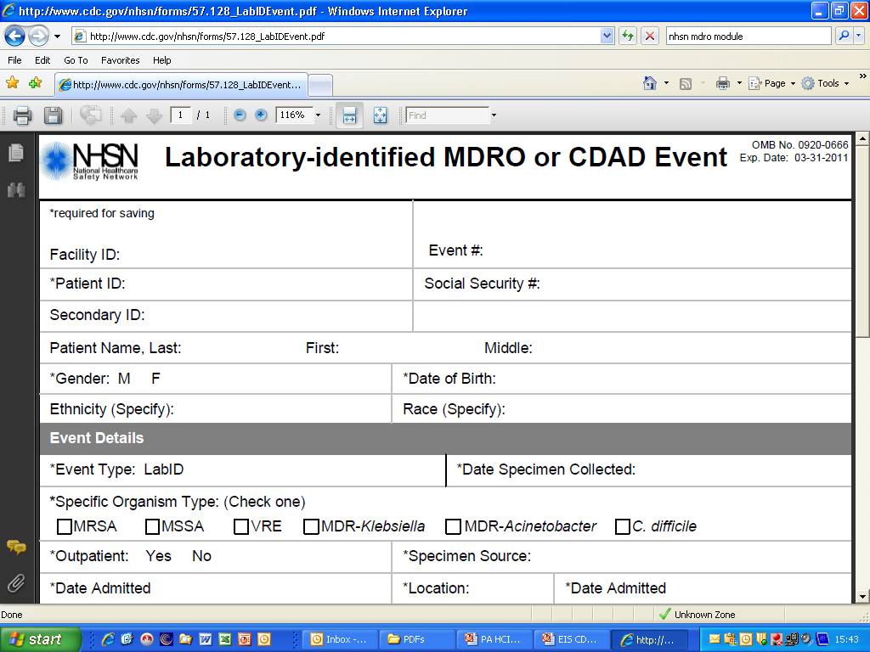
Measurement: Outcome
Use NHSN CDAD Module

Slide 26
Measurement: Outcome
Focus on Laboratory Identified (LabID)
Events in NHSN
Notes:
The same definitions for HO and CO-HCFA cases are used for the NHSN MDRO/CDAD module’s labID event reporting. The slide shows the labID event reporting form and the algorithm used to identify a LabID event. A positive CDAD (or CDI) test result is considered a labID event if there was no prior positive from that patient within the last 2 weeks (i.e., no duplicate).

Slide 27
Measurement: Outcome
NHSN Reporting: Definitions
Based on data submitted to NHSN, CDI LabID Events are categorized as:
Incident: specimen obtained >8 weeks after the most recent LabID Event
Recurrent: specimen obtained >2 weeks and ≤ 8 weeks after most recent LabID Event
Notes:
Based on data submitted on the forms, LabID events may be characterized as incident or recurrent cases.

Slide 28
Measurement: Outcome
NHSN Reporting: Definitions
Incident cases further characterized based on date of admission and date of specimen collection:
Healthcare Facility-Onset (HO): LabID Event collected >3 days after admission to facility (i.e., on or after day 4)
Community-Onset (CO): LabID Event collected as an outpatient or an inpatient ≤3 days after admission to the facility (i.e., days 1, 2, or 3 of admission)
Community-Onset Healthcare Facility-Associated (CO-HCFA): CO LabID Event collected from a patient who was discharged from the facility ≤4 weeks prior to date stool specimen collected
Notes:
The incident cases are further characterized based on the date of admission to the facility and the date the specimen was collected. The definitions for HO, CO, and CO-HCFA cases were described previously. At a minimum, hospitals should perform surveillance for HO cases, but a more complete assessment of the cases associated with a facility would include both HO and CO-HCFA cases.

Slide 29
Measurement: Outcome
Calculating CDI Incidence Rates*
Healthcare Facility-Onset Incidence Rate = Number of all Incident HO CDI LabID Events per patient per month / Number of patient days for the facility x 10,000
Combined Incidence Rate = Number of all Incident HO and CO-HCFA CDI LabID Events per patient per month / Number of patient days for the facility x 10,000
*For a given healthcare facility
Notes:
Facilities may therefore calculate an incidence rate based on HO cases per 10,000 patient days or a combined rate of HO and CO-HCFA cases per 10,000 days.

Slide 30
Evaluation Considerations
Assess baseline policies and procedures
Areas to consider
  Surveillance
  Prevention strategies
  Measurement of effect of strategies
Coordinator should track new policies/practices implemented during collaboration

Slide 31
References
Dubberke ER, Butler AM, Reske KA, et al. attributable outcomes of endemic Clostridium difficile-associated disease in nonsurgical patients. Emerg Infect Dis 2008;14:1031-8.
Dubberke ER, Reske KA, Olssen MA, et al. Short- and long term attributable costs of Clostridium difficile-associated disease in nonsurgical inpatients. Clin Infect Dis 2008:46:497-504.
Edmonds S, Kasper D, Zepka C, et al. Clostridium difficile and hand hygiene: spore removal effectiveness of handwash products. Presented at: SHEA 2009; Abstract 43.

Slide 32
References
Elixhauser, A. (AHRQ), and Jhung, MA. (Centers for Disease Control and Prevention). Clostridium Difficile-Associated Disease in U.S. Hospitals, 1993–2005. HCUP Statistical Brief #50. April 2008. Agency for Healthcare Research and Quality, Rockville, MD. http://www.hcup-us.ahrq.gov/reports/statbriefs/sb50.pdf
Fowler S, Webber A, Cooper BS, et al. Successful use of feedback to improve antibiotic prescribing and reduce Clostridium difficile infection: a controlled interrupted time series. J Antimicrob Chemother 2007;59:990-5.
Heron MP, Hoyert DLm Murphy SL, et al. Natl Vital Stat Rep 2009;57(14). US Dept of Health and Human Services, CDC; 2009. Available at http://www.cdc.gov/nchs/data/nvsr/nvsr57/nvsr57_14.pdf

Slide 33
References
Johnson S, Gerding DN, Olson MM, et al. Prospective, controlled study of vinyl glove use to interrupt Clostridium difficile nosocomial transmission. Am J Med 1990;88:137-40.
Mayfield JL, Leet T, Miller J, et al. Environmental control to reduce transmission of Clostridium difficile. Clin Infect Dis 2000;31:995–1000.
McDonald LC, Killgore GE, Thompson A, et al. An epidemic, toxin gene–variant strain of Clostridium difficile. N Engl J Med. 2005;353:2433-41.

Slide 34
References
McDonald LC, Coignard B, Dubberke E, et al. Ad Hoc CDAD Surveillance Working Group. Recommendations for surveillance of Clostridium difficile-associated disease. Infect Control Hosp Epidemiol 2007; 28:140-5.
Oughton MT, Loo VG, Dendukuri N, et al. Hand hygiene with soap and water is superior to alcohol rum and antiseptic wipes for removal of Clostridium difficile. Infect Control Hosp Epidemiol 2009; 30:939-44.
Peterson LR, Robicsek A. Does my patient have Clostridium difficile infection? Ann Intern Med 2009;15:176-9
Riggs MM, Sethi AK, Zabarsky TF, et al. Asymptomatic carriers are a potential source for transmission of epidemic and nonepidemic Clostridium difficile strains among long-term care facility residents. Clin Infect Dis 2007; 45:992–8.

Slide 35
References
SHEA/IDSA Compendium of Recommendations. Infect Control Hosp Epidemiol 2008;29:S81–S92. http://www.journals.uchicago.edu/doi/full/10.1086/591065
Stabler RA, Dawson LF, Phua LT, et al. Comparitive analysis of BI/NAP1/027 hypervirulent strains reveals novel toxin B-encoding gene (tcdB) sequences. J Med Micro. 2008;57:771–5.
Sunenshine RH, McDonald LC. Clostridium difficile-associated disease: new challenges from and established pathogen. Cleve Clin J Med. 2006;73:187-97.

Slide 36
References
Warny M, Pepin J, Fang A, Killgore G, et al. Toxin production by and emerging strain of Clostridium difficile associated with outbreaks of severe disease in North America and Europe. Lancet. 2005;366:1079-84.
Wilcox MF, Fawley WN, Wigglesworth N, et al. Comparison of the effect of detergent versus hypochlorite cleaning on environmental contamination and incidence of Clostridium difficile infection. J Hosp Infect 2003:54:109-14.

Slide 37
Additional resources
SHEA/IDSA Compendium of Recommendations
CDI Checklist Example
Dubberke et al. Infect Control Hosp Epidemiol 2008;29:S81-92.
Abbett SK et al. Infect Control Hosp Epidemiol 2009;30:1062-9.

Slide 38
Additional Reference Slides
The following slides may be used for presentations regarding CDI.
Explanations are available in the notes section of the slides.

Slide 39
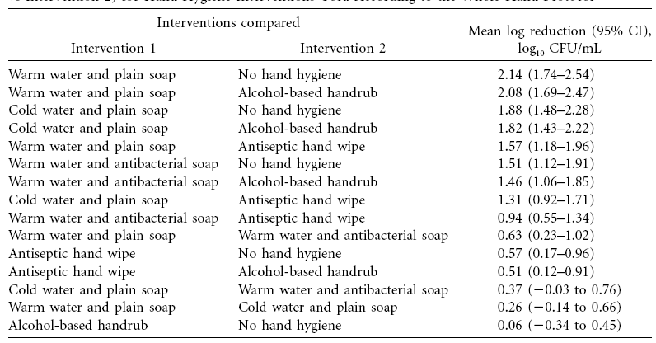
Supplemental Prevention Strategies:
Rationale for Soap and Water: Lack of efficacy of alcohol-based handrub against C. difficile
Oughton et al. Infect Control Hosp Epidemiol 2009;30:939-44.
Notes:
The rationale for recommending soap and water over alcohol-based hand hygiene for CDI patients comes from studies that have shown that alcohol-based handrubs are ineffective at removing spores from subjects’ hands that have been experimentally inoculated. In this study, soap and water achieved over a 2-log reduction while alcohol handrub had no effect.

Slide 40
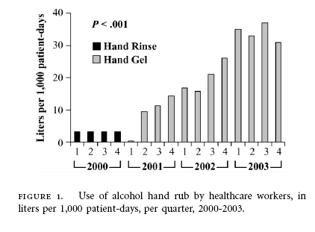
Supplemental Prevention Strategies:
Hand Hygiene – Alcohol Hand Rub Use 2000-2003
Boyce et al. Infect Control Hosp Epidemiol 2006; 27:479-83.
Notes:
This leads to the question of whether the increasing rates of CDI observed may be attributable to the increasing use of alcohol hand gel during this time.

Slide 41
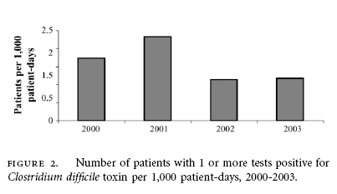
Supplemental Prevention Strategies:
Hand Hygiene – CDI Rates 2000-2003
Boyce JM et al. Infect Control Hosp Epidemiol 2006; 27:479-83.
Notes:
The answer is probably not. In this study, despite the increasing use of alcohol hand rub in this hospital, there was no concomitant increase in CDI rates. We also know that alcohol hand rub is more effective for other pathogens and improves compliance with hand hygiene; therefore discouraging its use may lead to untoward consequences for HAIs in general.

Slide 42
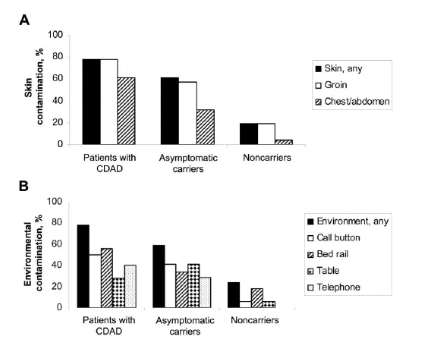
Supplemental Prevention Strategies:
Universal Glove Use
Role of asymptomatic carriers?
Rationale for universal glove use on units with high CDI rates
Riggs et al. Clin Infect Dis 2007;45:992–8.
Notes:
Another issue with cross-transmission is the potential role of asymptomatic C. difficile carriers. This study demonstrated skin and environmental contamination with C. difficile in asymptomatic carriers, although less so than in patients with CDI. We don’t know the contribution of asymptomatic carriers to transmission, nor do we have a practical screening test for these patients. However, on units with high endemic CDI rates, this may provide a rationale for universal glove use as a special approach to reducing transmission.

Slide 43
Supplemental Prevention Strategies:
Environmental Cleaning
How Much Can be Achieved via Environmental Decontamination?
Mayfield et al. Clin Infect Dis 2000;31:995–1000.
Notes:
The rationale for using bleach for environmental cleaning is that bleach is able to kill spores, whereas other standard disinfectants cannot. However, there are limited data that bleach cleaning reduces C. difficile transmission, and there are potential downsides to its use. This study did find a benefit of bleach cleaning in a unit with high endemic CDI rates. In this before-after intervention study, patients in 3 units were evaluated to determine if routine cleaning with unbuffered 1:10 hypochlorite solution in CDI patient rooms would reduce the incidence of CDI on those units. CDI rates decreased significantly in the bone marrow transplant unit (where endemic rates were high) after switching from quaternary ammonium to bleach. Rates increased with reversion back to quaternary ammonium. No reduction was seen in the other two units which had lower baseline CDI rates. Therefore, bleach may be most effective in reducing burden where CDI is highly endemic.

Slide 44
Supplemental Prevention Strategies:
Environmental Cleaning
Assess adequacy of cleaning before changing to new cleaning product
Carling et al. Clin Infect Dis 2006;42:385-8.
Notes:
Prior to switching disinfectants, hospitals must ensure that environmental cleaning is adequate (i.e., it doesn’t help to switch to bleach if high-touch surfaces are not being touched, which is often found during assessments of environmental cleaning in hospitals experiencing outbreaks). Carling used a method of targeting cleaning using a fluorescent environmental marker. In this evaluation, only 47% of high-touch surfaces in 3 hospitals were cleaned. The upper panel shows the % of specific high-touch objects cleaned before the intervention. After educational interventions were done with the environmental services staff, there was a sustained improvement in cleaning of all objects, shown in the bottom panel, with the most striking improvements in previously poorly cleaned objects. The use of environmental markers is a promising method to improve cleaning in hospitals.

Slide 45
Supplemental Prevention Strategies:
Audit and feedback targeting broad-spectrum antibiotics
Fowler et al. J Antimicrob Chemother 2007;59:990-5.
Notes:
This study demonstrated the impact of antimicrobial management on reducing CDI. This was a prospective, controlled interrupted time-series analysis in 3 acute medical wards for elderly people in the UK. Introduction of a narrow-spectrum antibiotic policy, reinforced by feedback, was associated with significant changes in targeted antibiotics and a significant reduction in CDI.

