Slide 1
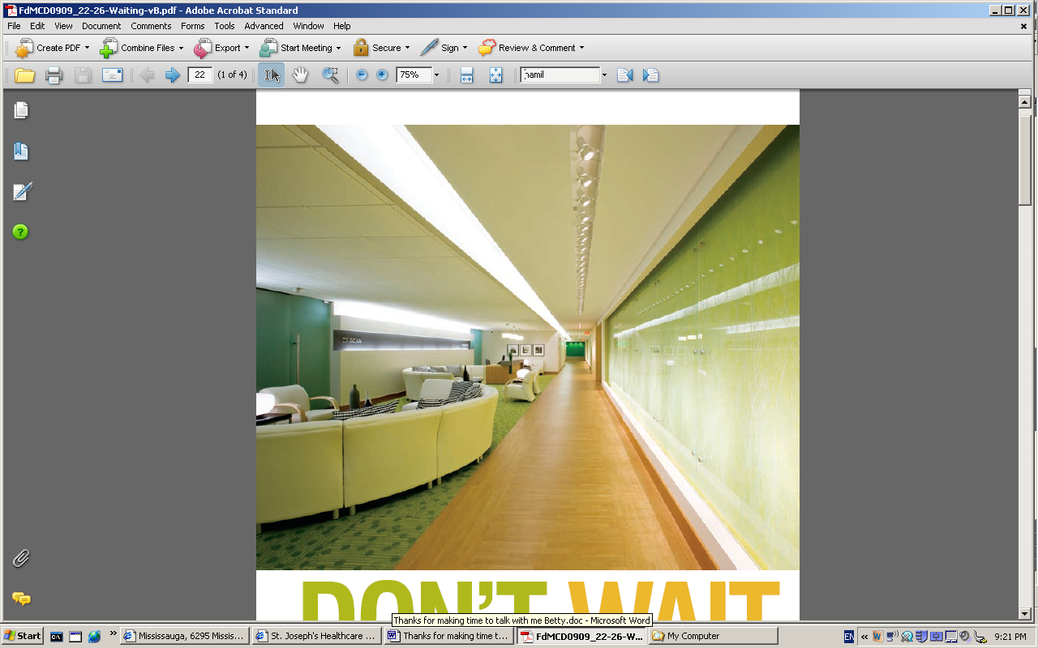
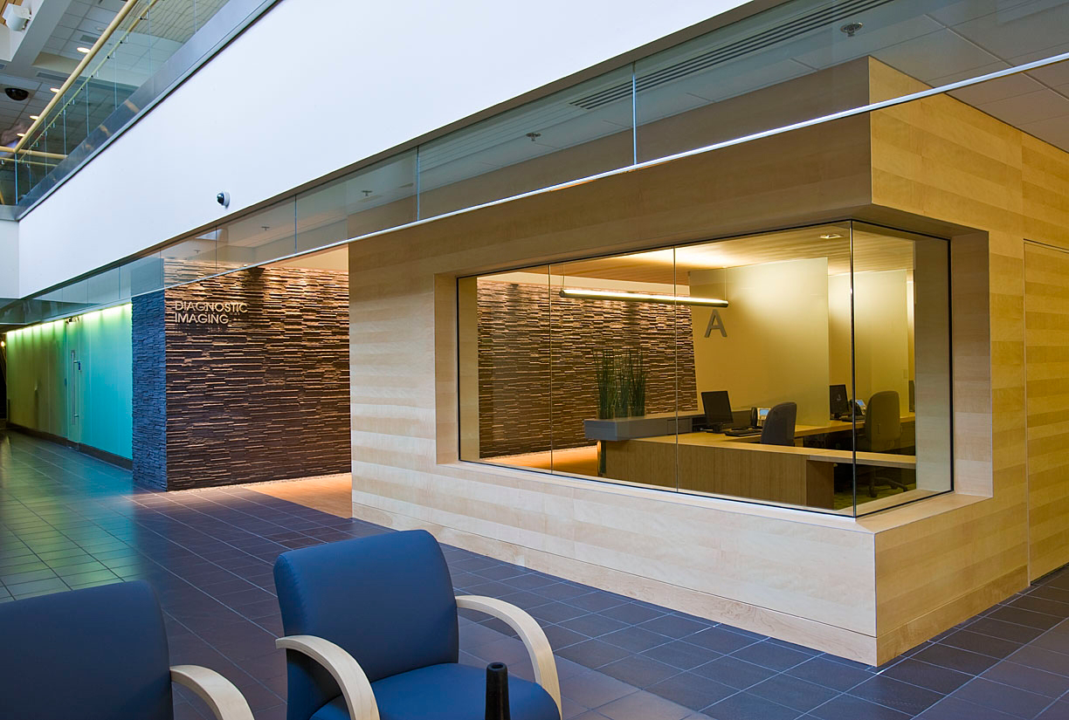
Building the
Patient Experience from the Inside Out
2010 Leading Practices Display
OHA November 8, 9 & 10, 2010
Outline:
Background
Purpose & Goals
Project Description
Outcomes
Lessons Learned
Participants
HOME
NEXT

Slide 2
Background
In 2007, the medical imaging department was required to relocate as part of a hospital-wide redevelopment project.
Research is surfacing about how the healthcare environment is linked to positive patient outcomes.
Evidence-based design helps create an environment in which patients and families feel as safe and comfortable as possible and promotes efficiencies in workflow to help decrease levels of anxiety in patients, families and care providers.
BACK
HOME
NEXT

Slide 3
Purpose & Goals
Designing a department to be
more efficient in the delivery of clinical care that is felt everyday by patients, families and staff.
Using lean architecture that reflects quality of care
BACK
HOME
NEXT

Slide 4
Hospital of the Future Project
to enhance the patient experience
Used simulation modeling and lean practices to “design-in” clinical benefits and inform an optimal architectural design that inherently supports the delivery of clinical care.
Engaged multidisciplinary teams to creatively think through improved ways of delivering care.
Initial design 40% less efficient workflow than current department. Final lean design 80+% more efficient.
BACK
HOME
NEXT

Slide 5
Outcomes
Sustained since 2008
Separated inpatient and outpatient journeys
Reduced patient travel distances by 8%
Increased clinical efficiency by 54%
Increased patient privacy in the Ultrasound rooms, CT prep rooms, and at Registration
Improved way-finding using lighting, color and texture
Decreased patient anxiety though the use of natural products and visual distractions
Improved Infection Control (e.g. operating room quality air for interventional rooms, hand washing sinks, etc.)
BACK
HOME
NEXT

Slide 6
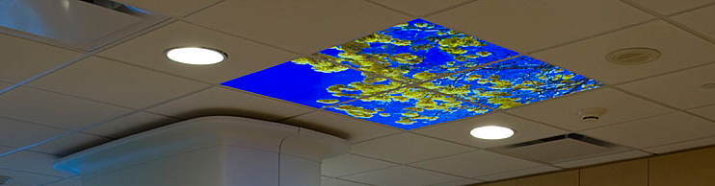
Medical Imaging CT Room
Use of natural products, and visual distractions to decrease patient anxiety (e.g. ceiling paintings)
Medical Imaging Waiting Area Each modality has a separate lounge with calm colors
Medical Imaging Registration
A visual numbering system directs patients to private registration areas
BACK
HOME
NEXT

Slide 7
Lessons Learned
Project was fostered by SJHH’s culture of continuous improvement, which fully engages the workforce in optimizing patient care environments outcomes.
Innovation
Staff
Involvement
Guiding
Principles
SJHH
Culture &
Leadership
Lean
Simulation
Patient
Centered
Design
BACK
HOME
NEXT

Slide 8
Thanks to all Participants!
Mary Ann Breitigam
Betty Ng
David Wormald
SJHH Diagnostic Imaging staff
GE Healthcare Team
For more information, please contact Betty Ng at bng@stjoes.ca
Manager, Diagnostic Imaging & Imaging Research Centre,
St. Joseph's Healthcare, Hamilton
BACK
HOME

