Slide 1






The SIMS Partnership
Transforming health care delivery
Enhancing the Patient Experience:
The Collaborative Development of a Standardized Electronic Tool for Referrals to CCAC In-Home Services in the Toronto Central LHIN
Shared Information Management Services
University Health Network
HOME
NEXT

Slide 2
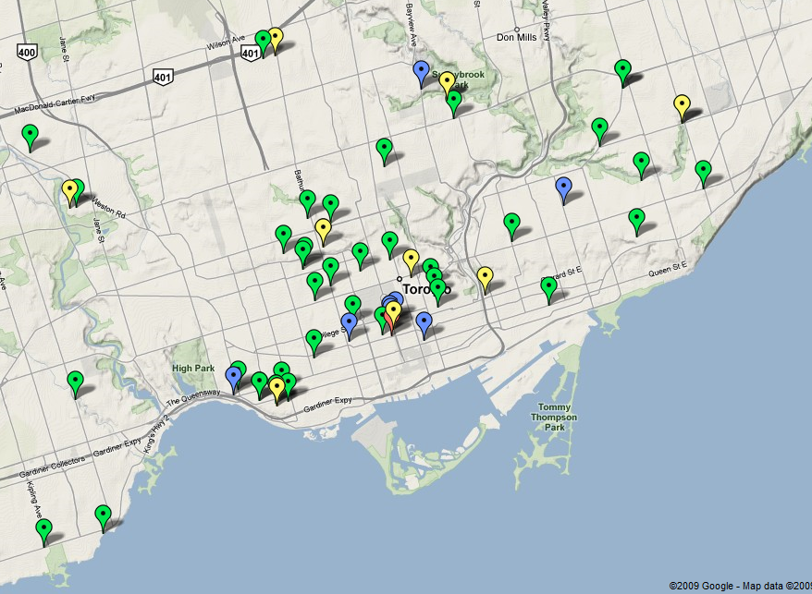
Resource Matching & Referral (RM&R) Project
RM&R: A secure electronic system that enables users to safely transmit referrals through the continuum of care
RM&R by the numbers:
  6 Acute (medicine/surgery units)
  8 Rehab/CCC
  Toronto Central CCAC
  37 Long Term Care (LTC) homes
17,189 registered users
30,000 logins per month
20,825 unique patients referred
(Aug/09 – July/10)
52 HSPs implemented across Toronto Central LHIN within 12 months
BACK
HOME
NEXT
Data Source: RM&R System Data, provided by RM&R Reporting Team.
Notes:
2
2
Huge traction with this program within TC LHIN thus far, but the journey is still on-going
Opportunity to impact ER/ALC
This is just the start – there is more work to be done

Slide 3
Project Approach – CCAC In-Home Referrals
Challenge: Fifteen organizations using different tools and processes to refer patients to CCAC In-Home services
Goal: To improve workflow and communication during the referral process through collaboration and standardization leading to better patient transitions
Approach to Standardization:
Stakeholder
Engagement
Fuzion
Test Drive
Early
Adopters
Implementation
Support
Fuzion
Business-to-business approach to collaboratively and iteratively review, redesign, and evaluate the CCAC In-Home form and processes
Test Drive
Dedicated sessions for front-line clinicians to:
Preview and test (using work flow based cases) new functionality
Proactively identify changes/improvements prior to use in live environments
BACK
HOME
NEXT

Slide 4



“Fuzion”: The Road to Standardization
Designed as an opportunity to bring together a cross-section of multi-disciplinary business stakeholders, from frontline staff to senior leadership, across all sectors
Over 40 participants from 15 sites worked collaboratively to design standardized processes and e-forms over 4 sessions
Stakeholder engagement and active participation were critical to the success of these sessions
Main Outcomes of Fuzion:
  Consensus between 14 hospitals and CCAC and multi sector stakeholders on single referral form and process
  Streamlined method for requesting CCAC to conduct an assessment for In-Home services
BACK
HOME
NEXT
Notes:
In addition to Critical Success Factors, that is:
Implementing a clear governance structure for decision-making, escalation, and accountability
Business-led sector organization and collaboration lay the foundation for the technical solution
Link to LHIN priorities
Key Success Factors:
Business Champions: Need business leads from each sector, suggestion to second resources for a year
Support for staff time: Provide funding to HSPs for internal change management and staff time
Education: Educate front-line staff on change management
Addressing process changes: Examples include the medical treatment form, cultural shift from treatment orders to request for CCAC assessment
4

Slide 5
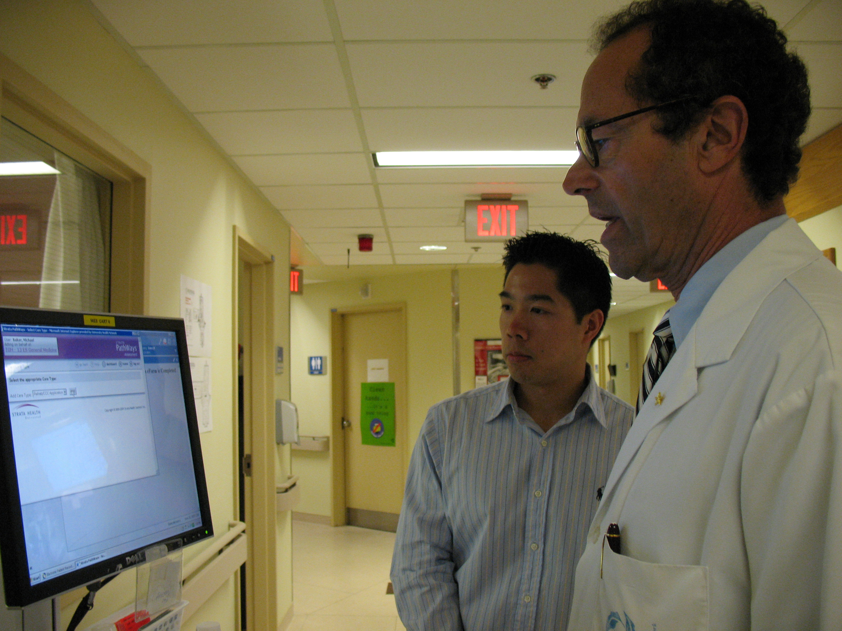
Time for a “Test Drive”
Prior to implementation of new CCAC In-Home electronic forms:
  Participants from all organizations tested that business needs were met by the revised referral forms
Sample clinical cases were provided
Users were able to simulate real-life scenarios
Main Outcomes of Test Drive:
  15 participating organizations (over 100 participants overall)
  148 distinct pieces of feedback regarding the CCAC In-Home Referral Form
  Collaborative review and approval of change requests
  59 recommended changes made prior to implementation
BACK
HOME
NEXT

Slide 6




Impact on Patient Experience
"What this system does is bring to us is one standardized process, one standardized place that the referral data is available. Everyone can have access to that data, for hospitals, long term care facilities, CCAC, in real time."
Executive Director, TC CCAC
All TC LHIN Acute/Rehab-CCC sites
Multi-disciplinary Healthcare Teams
1 Standardized Referral Form
Increased access to care:
6 Acute organizations
8 Rehab/CCC organizations
Patient Safety:
Standard forms and processes across organization
1 Comprehensive Care Plan for Patient
Patient Safety:
  Access to forms is permission based and ensures appropriate completion and sign-off on forms
  23, 801 CCAC In-Home referrals sent via RM&R from August 2009-August 2010
BACK
HOME
NEXT
Data Source: RM&R System Data provided by RM&R Reporting Team (Oct 2010).

Slide 7
Impact on Patient Experience
All TC LHIN Acute/Rehab-CCC sites
Patient Collaboration in Discharge:
“Early notification” functionality allows for early discharge planning
CCAC Hospital Care Coordinators can visit with patient early in discharge planning
Multi-disciplinary Healthcare Teams
1 Standardized Referral Form
1 Comprehensive Care Plan for Patient
  Patient Safety:
  Electronic forms are legible, accurate and comprehensive
  Satisfaction of users increased by 35%
  Use of mandatory fields ensure referrals are complete prior to sending
  23, 801 CCAC In-Home referrals sent via RM&R from August 2009-August 2010
BACK
HOME
NEXT
Data Source: RM&R Benefits Realization Assessment (Feb 2010).

Slide 8
Presented By:
Melissa Coulson, Project Manager
Alysia Catalano, Senior Analyst
Jocelyne Verity, Senior Analyst
Special Thanks to Our Participating Organizations:
Baycrest | Bridgepoint Health
Mount Sinai Hospital | Providence Health
St. Joseph’s Hospital | St. Michael’s Hospital
Sunnybrook Health Sciences Centre | Toronto Central Community Care Access Centre
Toronto East General Hospital | Toronto Grace
Toronto Rehab | University Health Network
West Park
BACK
HOME

