Slide 1






Tool for Building a Culture of Patient Safety:
Identifying Adverse Events for Disclosure and Reporting
Quality & Patient Safety
Dr. Paula Chidwick, Director Clinical & Corporate Ethics
Dr. Colleen Thomas, Director Quality & Patient Safety
HOME
NEXT
Notes:
1

Slide 2
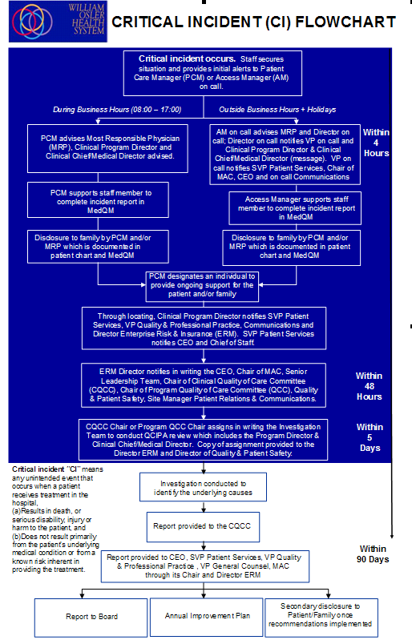

Building Capacity for Reporting and Disclosing Adverse Events
WILLIAM OSLER HEALTH SYSTEM
RISK MANAGEMENT NOTIFICATION
Multiple resources consulted, staff education delivered
and a variety of tools designed … BUT
BACK
HOME
NEXT

Slide 3
…… still we found staff often did not agree on what constituted an adverse event despite our multifaceted approach to education and capacity building.
With this in mind Osler’s Ethics and Quality & Patient Safety Programs developed a disclosure pocket tool to help staff identify adverse events.
We started with the definition of Adverse Event
Adverse events are unexpected events in healthcare that result in harm and are not attributable to recognized complications. Adverse events negatively impact a patient’s health and quality of life.
WOHC Disclosure of Adverse Events Policy, CPSI Canadian Disclosure Guidelines)
BACK
HOME
NEXT

Slide 4
We created a pocket tool based on the definition.
We asked four questions
If the answers to all four questions are “yes” then you are facing an adverse event.
Disclosure and reporting would follow
Once identification occurs obligations to disclose and report were clear and well understood.
BACK
HOME
NEXT

Slide 5
Data Snapshot: Tracking and Comparing Disclosures for Medication and Tests/Procedure Adverse Events (2009 – 2010)
BACK
HOME
NEXT

Slide 6

Lessons Learned …
1. Identifying adverse events was the first step in meeting our obligations to disclosure and report
BACK
HOME
NEXT

Slide 7
Lessons Learned …
2. Continue to support staff in preparing for meeting with patients and families on disclosure.
3. Continue to support staff on investigating cases
4. Continue to encourage staff to report incidents and show that reporting and disclosing adverse events is about identifying barriers to practice and making systems safe
BACK
HOME
NEXT

Slide 8
Contact information
Dr. Paula Chidwick
Director Clinical & Corporate Ethics
Ethicist
paula.chidwick@williamoslerhs.ca
905 494 2120 X56630
Dr. Colleen Thomas
Director Quality & Patient Safety
colleen.thomas@williamoslerhs.ca
905 494 2120 X57723
BACK
HOME

