Slide 1

Lessons from Alberta
Presentation by
Stephen Duckett
Professor
School of Public Health
Former President and CEO,
Alberta Health Services
Breakfast with the Chiefs, Toronto, 5 May 2011

Slide 2
Cost per Head
above Canada average
Alberta
2008
above Canada average
Life Expectancy
Canada average
Alberta
early-mid 1990s

Slide 3
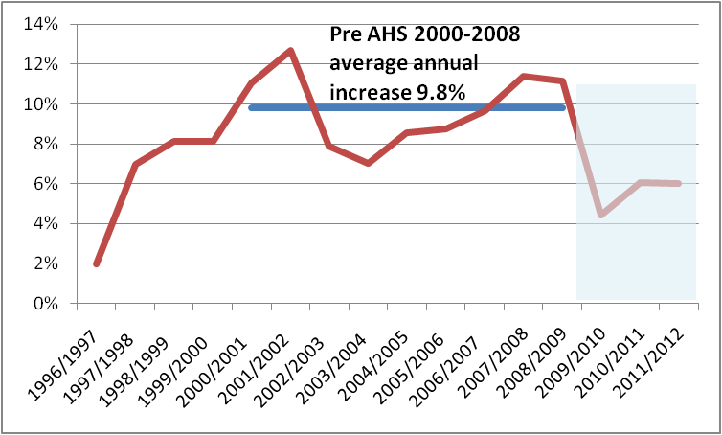
Annual increase in health spending* in Alberta
* to AHS and predecessor entities excluding EMS, AADAC

Slide 4
Summary
We have seen a steady deterioration in performance* over the last decade
* On practically any dimension you care to measure
Not just the last two (AHS) years!!!!
Demonstrable turn around for the health system (Alberta’s largest employer) cannot occur over night

Slide 5
Compared to other provinces, Alberta:
Spends more per head
Uses more health services
(and those health services cost more)
But doesn’t provide quicker access
Or appreciably better (population) outcomes

Slide 6
Presentations made previously
As CEO
  ‘Boom and bust again’ @UofA
Post CEO
  Health care forum, Centre for Public Interest Accounting @UofC

Slide 7
Why did performance deteriorate?
Edifice complex?

Slide 8
Capital growth in Alberta was higher than other provinces – driving increased hospital capacity
¹ Source: Statistics Canada, CANSIM, table 326-0021 and Catalogue nos. 62-001-X and 62-010-X.
² Source: Canadian Institute for Health Information, National Health Expenditure Trends, 1975 – 2008 (Ottawa, Ont.: CIHI, 2008).
³ Adjusted Population is Weighted by All-Sector Expenditure by Age and Gender (2007/2008 Population-Based Funding Weights for Alberta). Alberta’s weights were applied across all provinces.

Slide 9
Alberta spent 25% faster on Hospitals over the period than Other Provinces
¹ Source: Statistics Canada, CANSIM, table 326-0021 and Catalogue nos. 62-001-X and 62-010-X.
² Source: Canadian Institute for Health Information, National Health Expenditure Trends, 1975 – 2008 (Ottawa, Ont.: CIHI, 2008).
³ Adjusted Population is Weighted by All-Sector Expenditure by Age and Gender (2007/2008 Population-Based Funding Weights for Alberta). Alberta’s weights were applied across all provinces.

Slide 10
Compared to other provinces, Alberta disinvested in Seniors Accommodation and Other Institutions
¹ Source: Statistics Canada, CANSIM, table 326-0021 and Catalogue nos. 62-001-X and 62-010-X.
² Source: Canadian Institute for Health Information, National Health Expenditure Trends, 1975 – 2008 (Ottawa, Ont.: CIHI, 2008).
³ Adjusted Population is Weighted by All-Sector Expenditure by Age and Gender (2007/2008 Population-Based Funding Weights for Alberta). Alberta’s weights were applied across all provinces.

Slide 11
Why did performance deteriorate?
Edifice complex?
  ? (legitimate) mechanism to share oil wealth
Essentially no central (bureaucratic) oversight
  Politically powerful regional health authorities
Essentially no transparency/ monitoring/ benchmarking
  Emphasis on spin in RHAs
High level of political involvement and expectations
  ? Effect of rural gerrymander
  ? Effect of one-party government

Slide 12
What did we do (right)?
Be honest, lift the lid
Set strategic direction

Slide 14
What did we do (right)?
Be honest, lift the lid
Set strategic direction
Develop accountability framework

Slide 15
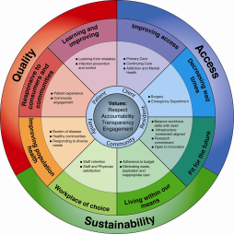
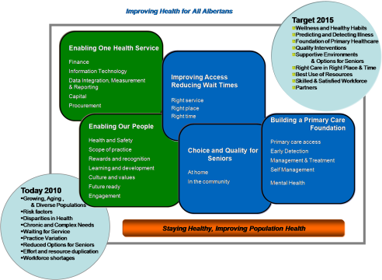

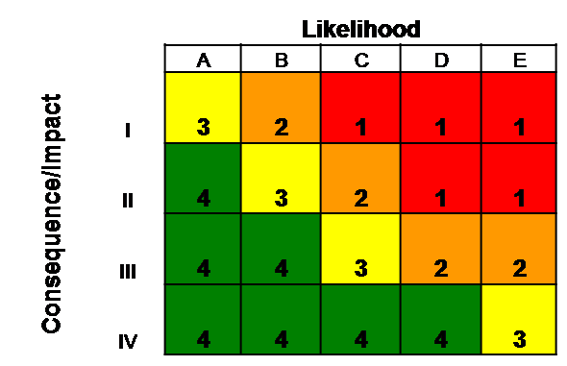
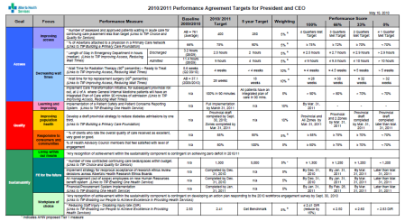
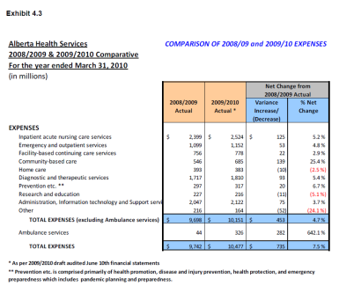
Plans, Reporting and Accountability
Measures reported in Quarterly
Public Performance Report
Increases likelihood
of achievement
Strategic
Direction
(3rd quarter)
Strategic
Health Plan
(TIPs)
Increases likelihood
of achievement via
Performance
agreements
Informs Refresh
(along with review of health needs etc.)
Annual Review of Risk
(3rd quarter)
Individual Performance Agreements
(1st quarter)
Operational Business Plan/Budget
(4th quarter)

Slide 16
What did we do (right)?
Be honest, lift the lid
Set strategic direction
Develop accountability framework
End Noah’s Ark planning

Slide 17
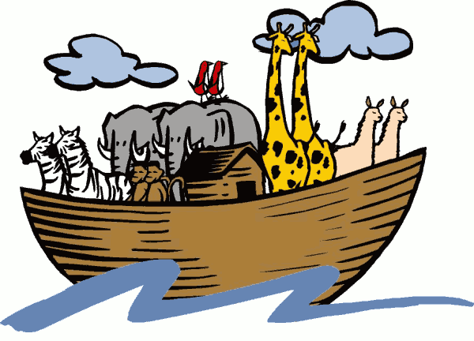

Slide 18
What did we do (right)?
Be honest, lift the lid
Set strategic direction
Develop accountability framework
End Noah’s Ark planning
  Or rather, attempt to end
Develop provincial approaches
  Organizational structures/roles

Slide 19
AHS Formal Structure: mutual accountability to the fore
President & Chief Executive Officer
Dr. Stephen Duckett
Chief of Staff Board Office
VP Community Engagement
EVP, Corporate Services
Mike Conroy
EVP & CFO
Chris Mazurkewich
EVP,
Strategy and Performance
Alison Tonge
EVP,
Quality and Service Improvement
Dr. Chris Eagle
EVP,
Rural, Public and Community Health
Pam Whitnack
EVP, Clinical Support Services
Andrew Will
Senior Physician
Executive
Dr. Dave Megran
VP Cancer Care
SVP Metropolitan Hospitals
VP Edmonton Zone
SVP Major Tertiary Hospitals
SVP Regional Hospitals
VP Central Zone
Associate Physician Executives
VP North Zone
SVP/CNO Nursing Strategies
VP South Zone
VP Quality Practice & Partnerships
VP Pharmacy Services
SVP
Human Resources
VP Calgary Zone
Zone Medical Directors (5)
VP Allied Health Strategies
VP Primary Care & Chronic Disease Mgmt.
VP Diagnostic Imaging Services
SVP Communications
SVP Finance
VP Strategic & Service Planning
SVP Quality Improvement
Senior Medical Directors
VP Seniors Health
VP Laboratory Services
SVP & CIO Information Technology
SVP Capital Management
SVP Research
Patient Concerns
VP Addiction & Mental Health
VP Nutrition & Food Services
VP Internal Audit & Enterprise Risk Management
VP Data Integration, Measurement & Reporting
SVP Contracting, Procurement & Supply Management
VP Community
& Rural
VP Environmental Services
SVP & General Counsel, Legal & Privacy
VP Health Info Mgmt
SVP Emergency Medical Services
Exec. Director Linen Services
SVP Major Capital Projects
Exec. Dir. Patient Access & Capacity Mgmt.
Ethics & Compliance Officer
VP Population & Public Health
Exec. Director Protective Services
Notes:
Setting the stage

Slide 20
What did we do (right)?
Be honest, lift the lid
Set strategic direction
Develop accountability framework
End Noah’s Ark planning
  Or rather, attempt to end
Develop provincial approaches
  Organizational structures/roles
  Networks
  Alberta Clinician Council
  Activity based funding etc
Right investments

Slide 21
What went wrong?
? No pre-merger planning
Wasted first year
No consumer/local engagement mechanisms at all for 20 months (May 2008 – January 2010)
  Disengagement
  Legitimacy
(Rural) MLA disconnect
Budget cut
  Community reaction – identified as AHS’ choice
Site leadership vacuum
Role of Ministry vs AHS?
  Personality dependent

Slide 22
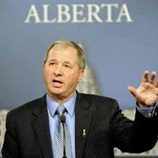
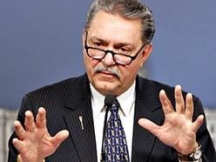
Chalk and cheese:

Slide 23
What went wrong?
? No pre-merger planning
Wasted first year
No consumer/local engagement mechanisms at all for 20 months (May 2008 – January 2010)
  Disengagement
  Legitimacy
(Rural) MLA disconnect
Budget cut
  Community reaction – identified as AHS’ choice
  No data for strategic cuts
Site leadership vacuum
Role of Ministry vs AHS?
  Personality dependent
Cookies?

Slide 24
What are the lessons?
(At least in Alberta) significant savings can be made from improved management
  Procurement
    Private sector contracts
  Activity based funding
  Using expertise
    Catering
  Economies of scale
    Provincial on-line formulary
(At least in Alberta) significant service enhancements can be made from collaboration vs competition
  EDs

Slide 25
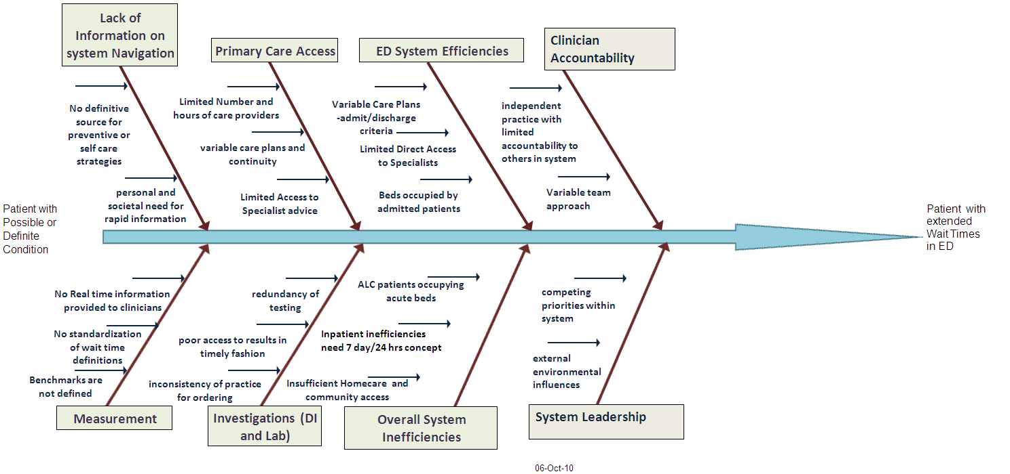

Slide 26
What are the lessons?
Change takes time
Change appetite varies over time
Public perception of health system performance unrelated to measures
  ? Boiling frog
  spin
Lambs get slaughtered

Slide 27
Cost per Head
above Canada average
Alberta
2008
above Canada average
Life Expectancy
Canada average
And back here again?
Alberta
early-mid 1990s

