Slide 1

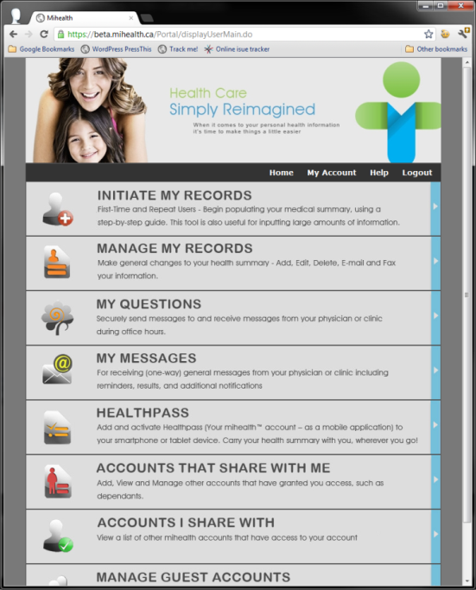
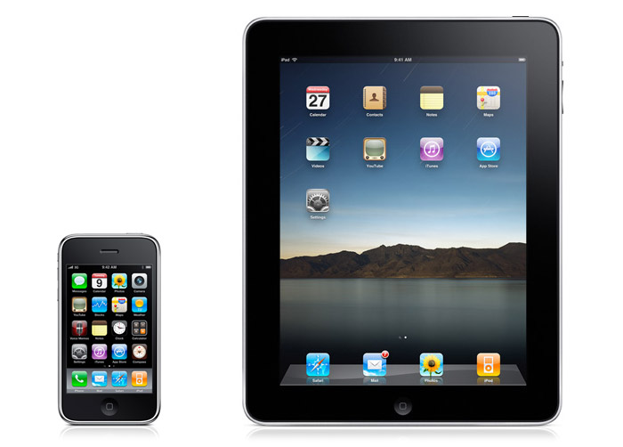

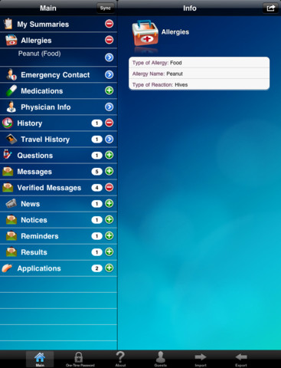
Can We Motivate Ourselves to Better Health?
Breakfast with the Chiefs
January 22nd, 2013
Slide 1

Slide 2

Coke – What Else Haven’t I Done?
Slide 2

Slide 3
2013 – The Year of Digital Health Patient Engagement
The curve of innovation will shift to a new course for managing disease and wellness and these are the touch points of change¹:
Explosive new technology (ie. Smartphones, tablets, point of care devices)
Pressing need to advance affordable healthcare and improve outcomes
Increasing dependency on patient and caregiver connectivity with telemedicine
The power of cool
Pharma’s shift from drugs to preventative care innovation
Self-health monitoring – Consumerism comes of age
Big Data and the electronic medical record
Money – Increasing role of venture capital in health care
The moral imperative
Important New advancements as seen by Dr. Joseph Kim²:
Global health: The use of mobile technologies in developing countries to significantly bridge health care gaps
Empowering patients: Use of smartphones or tablets
More data: Patients use of self-monitoring gadgets for disease management
¹http://www.forbes.com/sites/johnnosta/2013/01/02/2013-the-year-of-digital-health/ - John Nafta
²http://searchhealthit.techtarget.com/healthitexchange/PracticalHealthIT4Docs/a-few-thoughts-from-the-mhealth-summit-2012/?track=NL-1453&ad=884339&asrc=EM_NLN_20195127&uid=15040693&utm_medium=EM&utm_source=NLN&utm_campaign=20130103_See+which+health+IT+trends+to+watch+in+2013_jlaurello
Slide 3

Slide 4
Eric Topol, Creative Destruction Medicine
New Medicine
Wireless Sensors
-Real time, Hospitals & Communities
- Commodity Priced
Creative Destruction
Mobile Connectivity + Bandwidth
-Search of healthcare apps up 134%
Genomics
- Low cost
-Cradle to grave
Internet
Super Convergence
Imagine
Social Networking
Information Systems
↑ Computing Power & Data Universe
Old Medicine
Think of the cell phone as a hub of telecommunication for health convergence—a remarkable number of devices rolled into one gadget: the Reflex Pulse Oximeter, Genomics, and a Heart Monitor.
Slide 4

Slide 5
Provincial Budget Balances
$ Millions 11-12(p) 12-13 (p)
Federal -24,900 -21,100
NL 776 -258
PEI -79 -75
NS -261 -211
NB -471 -183
QC -3,300 -1,500
ON -15,000 -14,800
MB -1,120 -460
SK 353 47
AB -23 -886
BC -2,497 -968
Total Provincial -21,622 -19,341
Total Federal/Provincial -46,522 -40,441
Source: RBC. Provincial Fiscal Tables. Economics. Research. July 4, 2012
p=projected
Slide 5
Notes:
After another budget season there is still lots of red ink here and its one of the reasons why there is so much concern about reducing deficits
On the health front, the provinces will be spending about $130 billion on health care in 2012-13 based on the documents tabled this spring. This is an increase of 3.6 per cent over the forecasted or revised expenditures for the previous year and is within the target range set by the federal government’s change to Canada Health Transfer (CHT) payments effective in 2017-18.

Slide 6







OECD: Physicians per 1000 Population - 2010
Country Per 1000
1. Greece 6.1
2. Austria 4.8
3. Norway 4.1
4. Portugal 3.8
4. Sweden 3.8
4. Switzerland 3.8
OECD Average 3.1
Canada 2.4
Slide 6
Source: OECD Health Data 2012

Slide 7
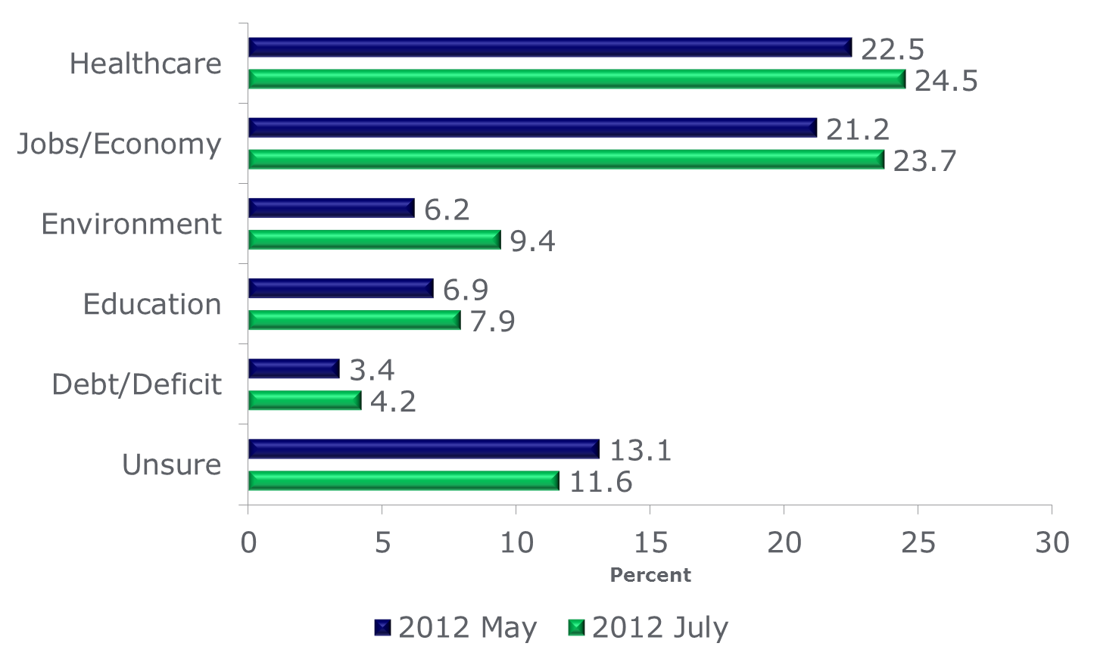
Most Important National Issue - Nanos Research
Source: Nanos Research. Healthcare and the economy remain top national issues of concern. Media Release July 19, 2012
Slide 7
Notes:
This is a regular poll that Nanos conducts, asking Canadians what they believe to be the most important national issue at the moment
Healthcare and the economy remain the top issues of concern for Canadians and are still running neck-and-neck for the number 1 position
The environment has again vaulted back into third place, ahead of education

Slide 8
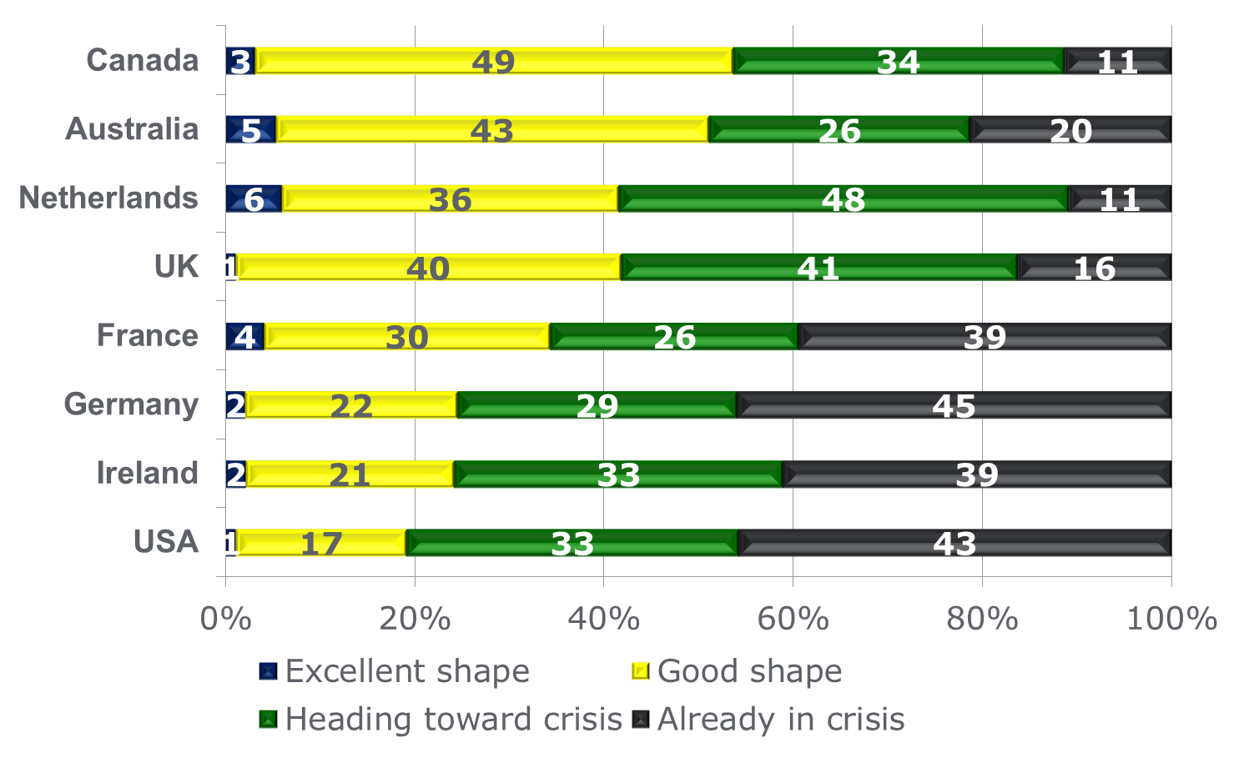
Overall assessment of the health care system
Source: Environics Research Group. Health orientations in Canada and around the globe. March 28, 2012
Slide 8
Notes:
This slide reinforces what the previous study found
This is from a global survey of 28 countries conducted last fall by Environics looking at issues around health care and personal wellness
These slides will give you an idea of how Canadians views compare to those of some other advanced economies
In this one Canadians believe our system is not doing too badly, at least compared to those below us in the chart
As you can see in the green bar 34% of Canadians think the system is headed for a crisis, the same as the previous study saying that 34% see the system worsening in the next 5 years

Slide 9
Who are we innovating our health systems for?
On average, health care spending is highly concentrated with the top 5% of the population (ranked by cost) accounting for 66% of expenditure
Source: Wodchis, W.P., (2012). The Concentration of Health Care Spending: Little Ado (yet) About Much (money). Institute for Clinical Evaluative Sciences, 10
Slide 9

Slide 10
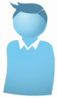
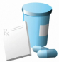
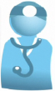
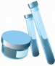
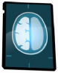
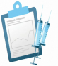
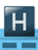
Availability of information for authorized users
Client Demographics
99.8%
Dispensed Drugs
54%
Provider Demographics
99.9%
2012
Lab Test Results
71%
Diagnostic Images
99%
Clinical Reports
or Immunizations
83%
Telehealth Videoconferencing in 90% of Hospitals
Note: Availability does not measure the extent of use by providers, but rather the information and systems that are in place.
Slide 10
Source: CHI 2012

Slide 11
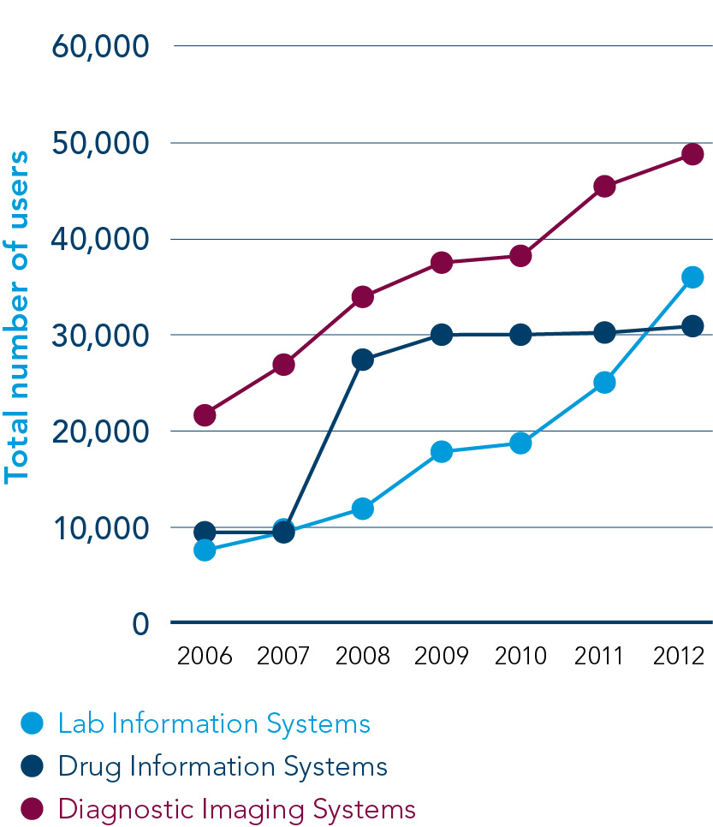
Electronic health record use
Source: Canada Health Infoway Annual Report 2011-2012
Slide 11

Slide 12






EMR Program – June 2012
EMR Program Start-up
EMR Program
Ambulatory EMR
EMR Upgrade
Slide 12

Slide 13
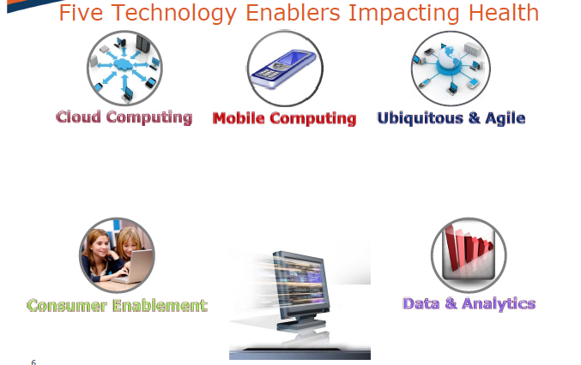
Slide 13

Slide 14
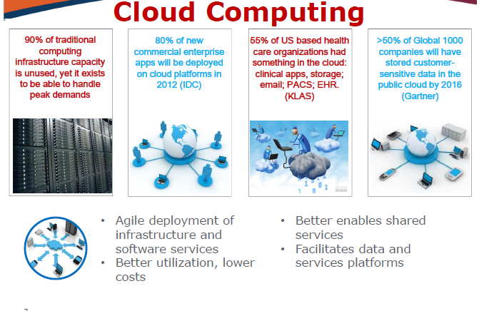
Slide 14

Slide 15
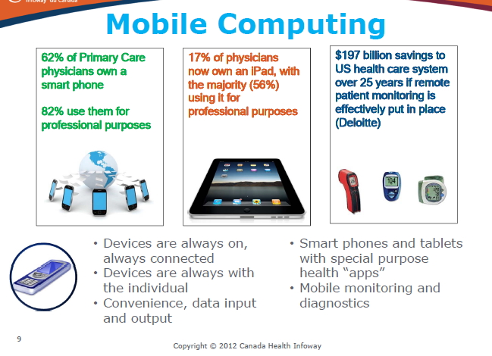
Mobile Computing
Slide 15

Slide 16
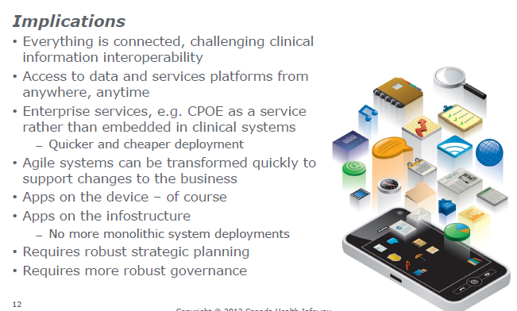
Ubiquitous and Agile
Slide 16
© Dr. Wendy Graham 2013

Slide 17
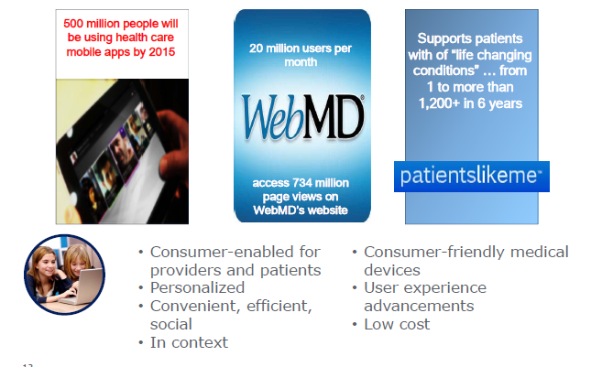
Consumer Enablement
Slide 17
© Dr. Wendy Graham 2013

Slide 18
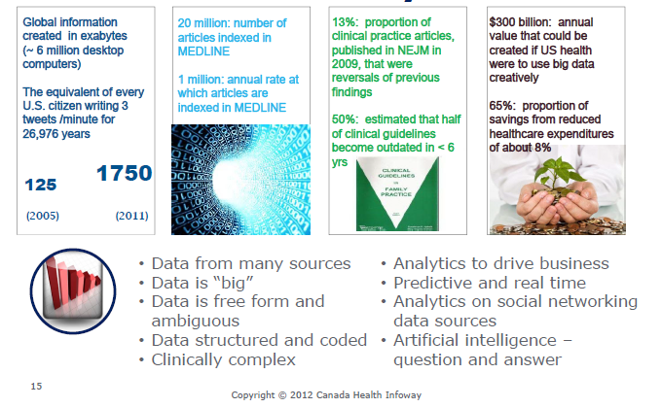
Data Analytics
Slide 18
© Dr. Wendy Graham 2013

Slide 19
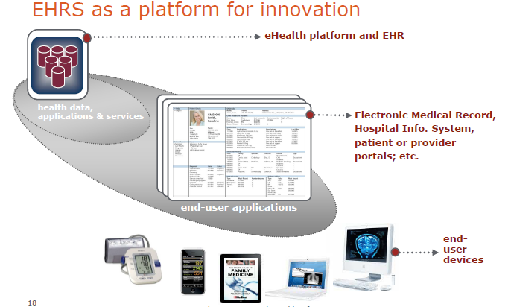
Slide 19
© Dr. Wendy Graham 2013

Slide 20
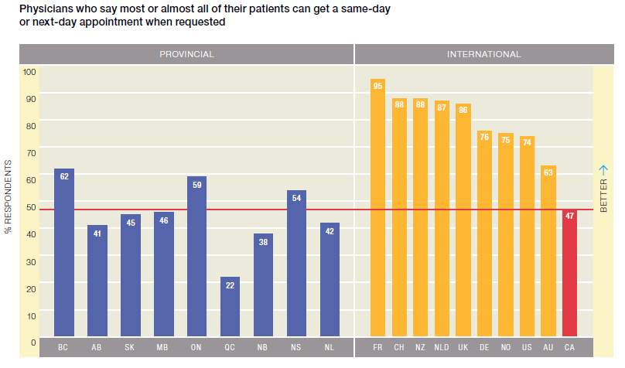
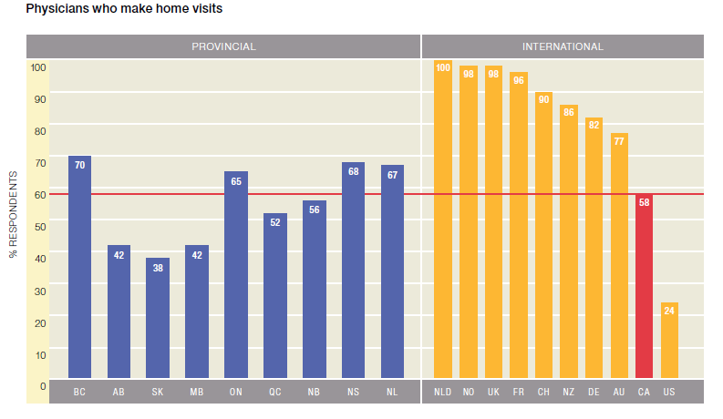
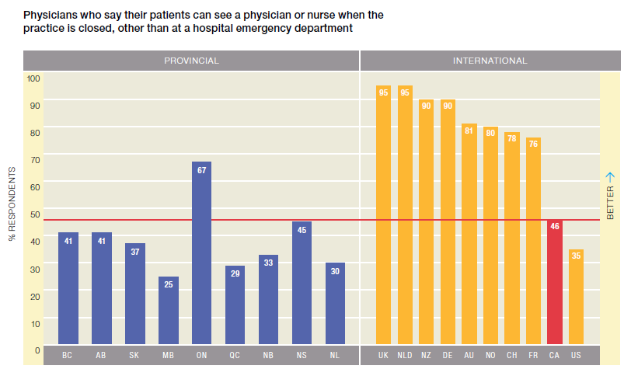
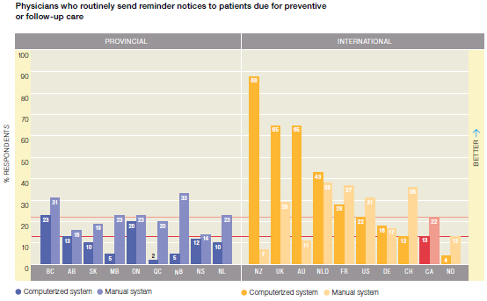
How Canadian Primary Care Physicians Rate the Health System (HCoC Jan 21st, 2013)…
Source: Health Council of Canada. (2013) How do Canadian primary care physicians rate the health system?
Slide 20
© Dr. Wendy Graham 2013

Slide 21
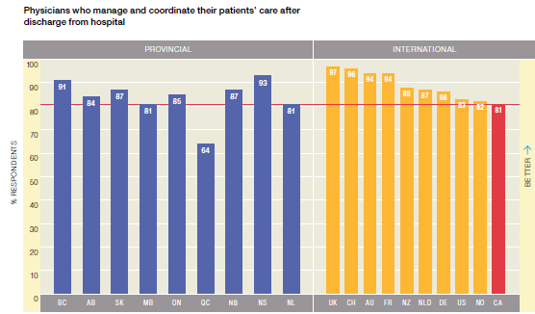
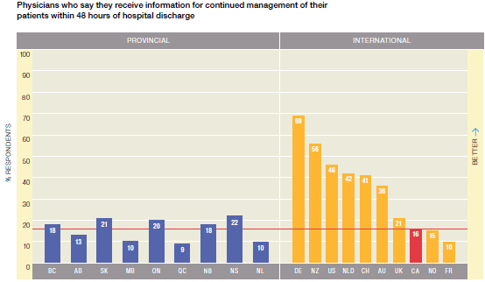
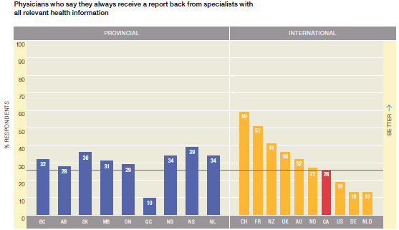
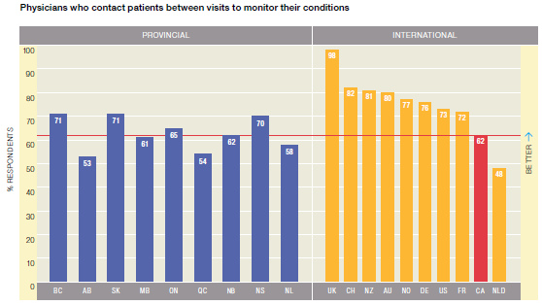
How Canadian Primary Care Physicians Rate the Health System (HCoC Jan 21st, 2013)…
Source: Health Council of Canada. (2013) How do Canadian primary care physicians rate the health system?
Slide 21
© Dr. Wendy Graham 2013

Slide 22

What the Public Wants Most
Second-Level Priorities
Restoring health when ill
Efficiency
Timeliness
Aggregate-Level Statistics
Kindness
Equity
Hope & Certainty
No Conflicts of Interest
Continuity, Choice, and Coordination
Lowest Priority
Real Cost
Private Room
Percent GNP Devoted to Health Care
No Out-of-pocket Costs
The Best Medicine
Allan S. Detsky, MD, PhD, JMAA, December 14, 2011-Vol 306, No. 22
Slide 22
© Dr. Wendy Graham 2013

Slide 23
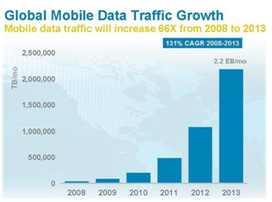
Simplicity + Immediacy + Secure Seamless Mobile Cloud Solution + Cost Containment + Improved Access = Market Opportunity
PHR market is projected to be $19B¹
The percentage of physicians and hospitals adopting comprehensive electronic health records by 2019 - 70%²
60% of consumers express interest in health record access and connection to providers³
Consumer mobile and tablet use skyrocketing⁴
More than 75% of the $2 trillion spent annually in US medical care is spent on chronic conditions⁵
Mihealth enables access to healthcare information across the ‘Circle of Care’, unlocking the value for both patient and physician
Center for Information Technology Leadership (CITL)
Congressional Budget Office Quoted in: CBS Money Watch, February 24, 2009
Deloitte, 2009.
http://www.openminds.com/institute-behavioral-health-informatics/ibhi-keynote-green.pdf
National Health Spending By Medical Condition, 1996–2005” “Health Affairs”, February 2009, w358-376.
Slide 23
© Dr. Wendy Graham 2013

Slide 24
What is the Ontario Healthcare System?
The Ontario healthcare system is a $47 billion (2011 – 2012) enterprise
    211 Hospitals
    900+ Independent Health Facilities (IHFs) – Privately owned
      617 diagnostic imaging IHFs (~$550 million in billing 11-12)
    ~13,000 family physicians, ~10,000 specialty physicians, ~3,300 surgeons
      $11 Billion (11-12) in physician billings (almost double from 03-04)
    Community labs owned by 9 private corporations
      3 corporate owned labs provide 95% of lab services
    Per capita annual expenditure $5,792
      3rd lowest in Canada behind PQ and BC
      below Canadian average $5,811
    Would rank no 58 on Fortune
      Ahead of Coca Cola, Lockheed-Martin, and Cisco
      Reference: Zain Mujtaba, DSPB MOHLTC
Slide 24
© Dr. Wendy Graham 2013

Slide 25
MOHLTC-Provider Relationship Management: Doctors
  Relationship managed through Ontario Medical Association (OMA)
  Fees and payments agreed upon by negotiation with OMA
    Negotiations take place every 4 years resulting in the Physician Services Agreement (PSA)
  OHIP Insured services, quality standards, and payments covered by PSA
    Addenda/Amendments to PSA take place continuously
    OMA/MOHLTC sub-committees negotiate any changes or additions
  PSA is a critical legal document and contains many important clauses relating to funding, services, quality etc.
    Can provide key information on how to manage/direct relationship with doctors and other service providers
  Services Fees listed in Schedule of Benefits resulting from PSA
    Two kinds of fees negotiated
      Technical (T) Fees: used for imaging/diagnostic test, paid to testing providers
      Professional (P) Fees: used to compensate Drs who evaluate tests
  Speciality Doctors paid fee-for-services
    Some specialty Doctors (e.g. Pathologists) are salaried hospital staff paid out of global budgets
  Family Doctors have choice,
    Can either practice in Fee-for-service (FFS), or
    Capitated group practice models (Family Health Organizations, Family Health Networks, Family Health Groups)
Slide 25
© Dr. Wendy Graham 2013

Slide 26
Key Pressures: Driving ALL Decision Making
Rising Costs
Aging Populations
Increasing Childless Retirees and Seniors
Declining Health Human Resources
Rapidly Changing Technologies
Increasingly Complex Disease Treatments
Rising Chronic Diseases
Urbanization of Service Providers
No Compromise on Equity or Quality
      Reference: Zain Mujtaba, DSPB MOHLTC
Slide 26
© Dr. Wendy Graham 2013

Slide 27
Health Links – The Ontario Govt’s Vision
Collaboration - Health Links encourages the idea of collaboration and coordination amongst health care providers to support patients at all levels of the health system.
Involving all Stakeholders - Involves all stakeholders (family care providers, specialists, hospitals, long-term care, home care and other community supports) in patient care.
Patient Involvement - Health Links will work closely with patients, so that health care providers can formulate an individualized plan, and ensure the plan is being followed.
Information/Resource Sharing - Health Links will facilitate information sharing and improved coordination amongst stakeholders, which will allow patients to receive faster care and spend less time waiting.
Outcomes Measurements - Health Links will measure results and develop plans to improve access to family care, reduce avoidable emergency room visits, reduce hospital re-admissions, etc.
Other - Health Links aims to manage patients with complex chronic disease using a comprehensive, integrated, easy to navigate, and collaborative approach across the entire health care system.
Slide 27
© Dr. Wendy Graham 2013

Slide 28
Family Care Giver Priorities
Adopting innovative technologies to enhance home care delivery
Ensuring high quality best cost home care solutions
  Outcomes
    Improved system sustainability for dementia/depression
    Reduced per capita costs for defined populations
    Reduced emergency room visits
    Decreased hospital stays
Slide 28
© Dr. Wendy Graham 2013

Slide 29
The Business Case for Patient Portals – Forbes, Oct 2012)
A modern patient portal enables the following items:
Marketing & market share
  Provide non-patient specific updates to cohorts of patients via newsletters and social media
  Searching for health information is the third most common activity on the web
Accountable model success depends on patient engagement
  Studies have shown that patient engagement is the blockbuster drug of the century
  Traditionally, 100% of health IT investment went towards <1% of a patient’s life when they were in front of the provider
Administrative savings
  Paper-based forms introduce potential errors, is a horrible consumer experience, and has a significant cost
  ROI can be 20:1 or higher when replacing paper-based systems
Avoiding vendor lock-in
  Patients want to use the same portal when they visit and different provider
Patient satisfaction
  Strong communication is the foundation that builds trust in a personal or professional relationship
SOURCE: http://www.forbes.com/sites/davechase/2012/10/21/is-there-a-business-case-for-engaging-patients/
Slide 29
© Dr. Wendy Graham 2013

Slide 30
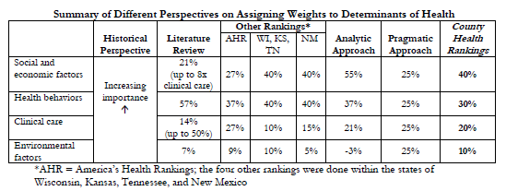
Weighting of Determinants to Health
Source: Country Health Rankings Working Paper: Different Perspectives for Assigning Weights to Determinants of Health, 2012, Population Health Institute
Slide 30
© Dr. Wendy Graham 2013

Slide 31
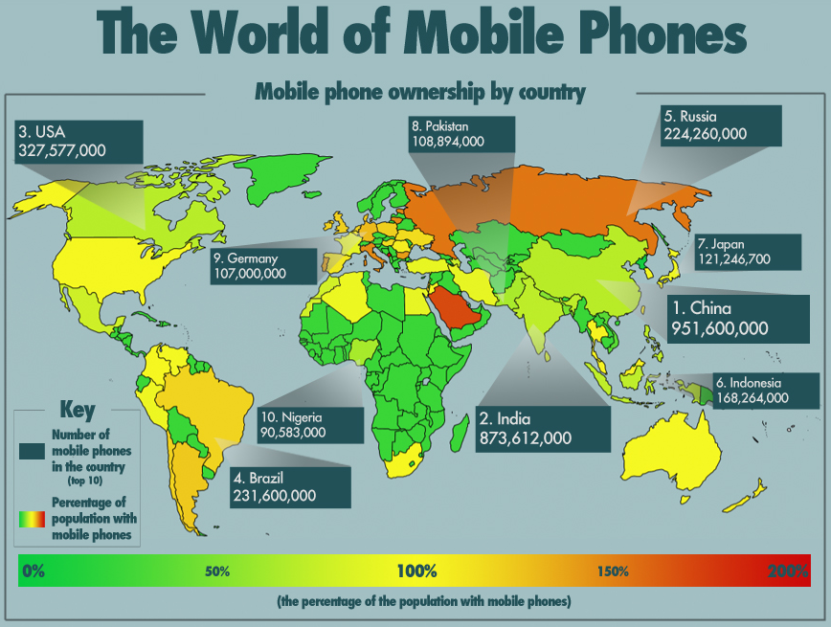

Sources:
Slide 31
© Dr. Wendy Graham 2013

Slide 32
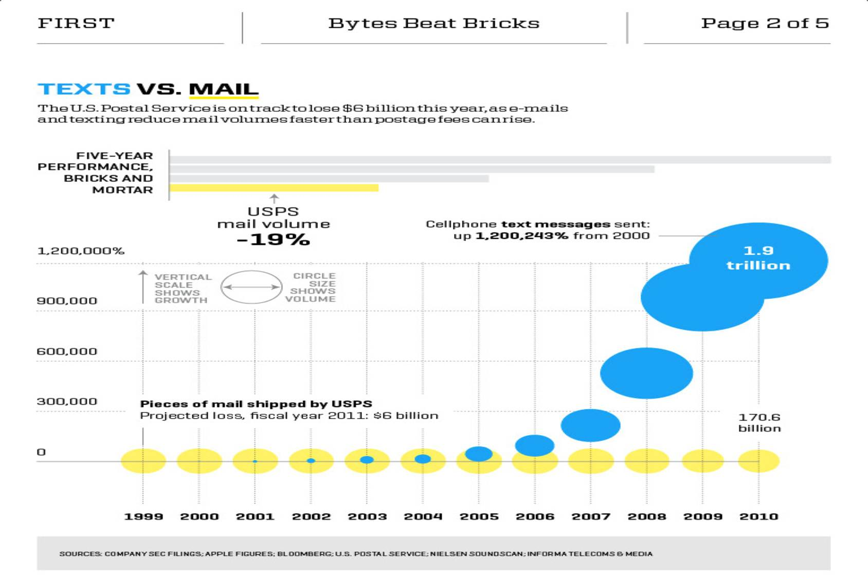
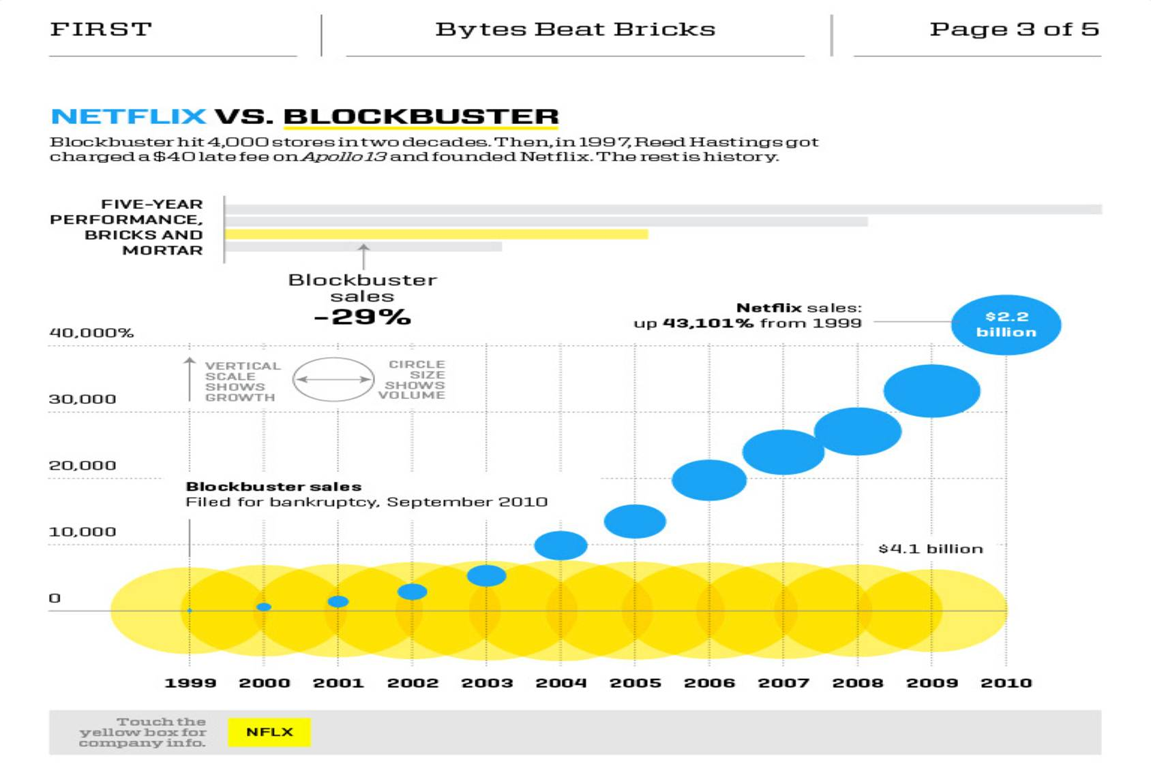
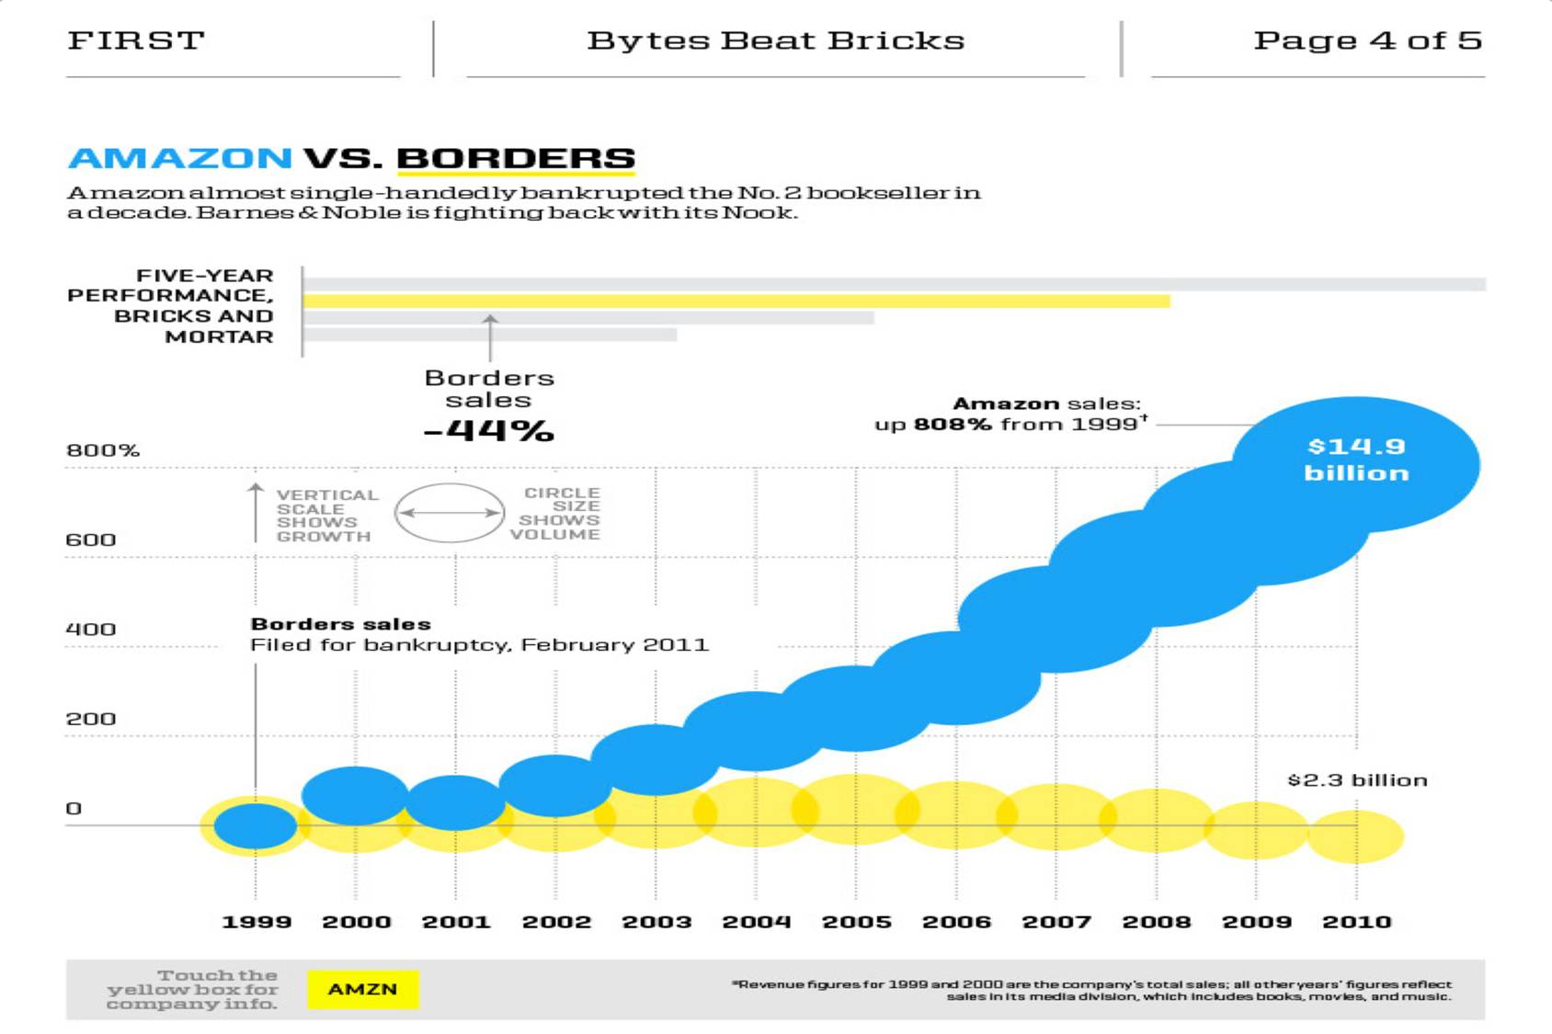
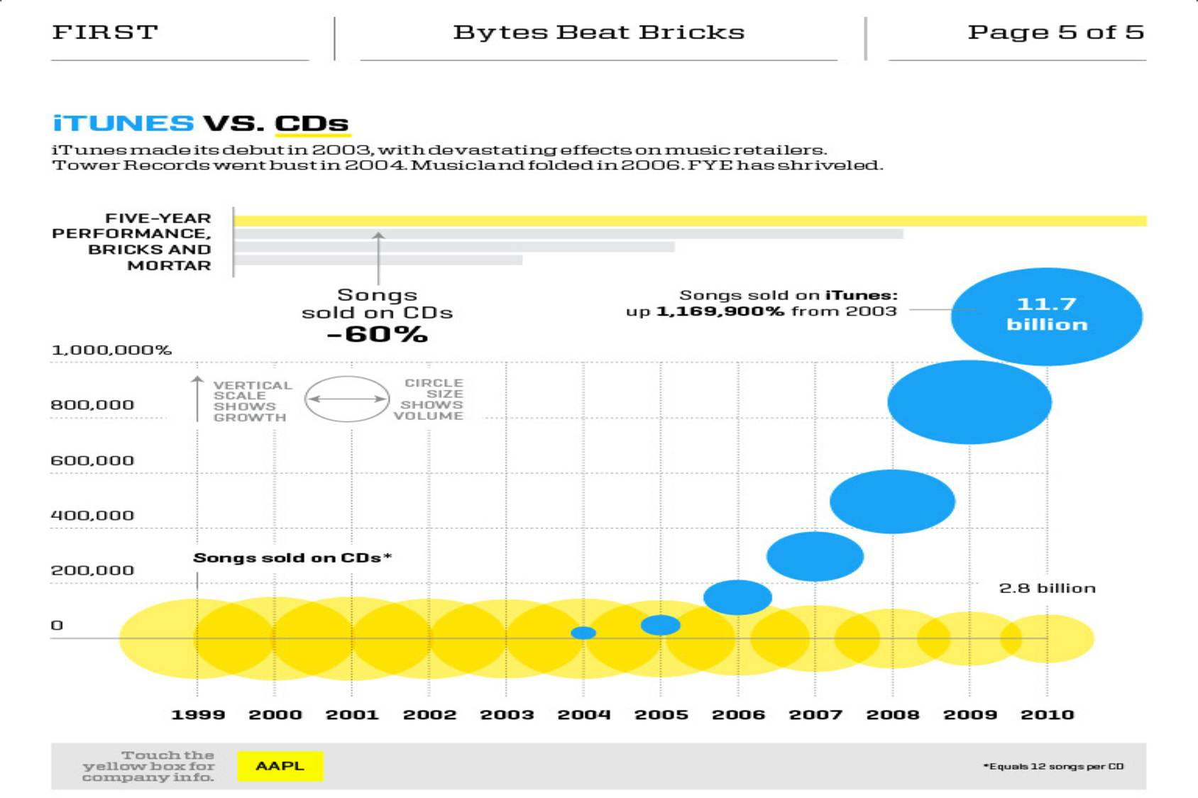
Slide 32
© Dr. Wendy Graham 2013

Slide 33

Unsecured Email is like Sending your Health Information on a Postcard
Slide 33
© Dr. Wendy Graham 2013

Slide 34
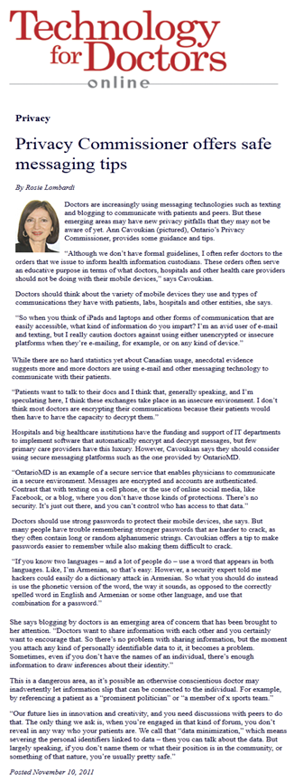
Blogging & Privacy is an Emerging Concern, be Cautious
“I’m an avid user of e-mail and texting, but I really caution doctors against using either unencrypted or insecure platforms when they’re e-mailing, for example, or on any kind of device.”
“Doctors want to share information with each other and you certainly want to encourage that”
Quotes from:
Ann Cavoukian, Ph.D.
Information & Privacy Commissioner
Ontario, Canada
Nov. 10, 2011
Slide 34
© Dr. Wendy Graham 2013

Slide 35
Alberta Privacy Commissioner – July 2012
Emailing patients can improve health outcomes and overall efficiency. Examples Include:
sending appointment reminders
Setting up specialist appointments
Offer a new service, such as a smoking cessation program, or diabetes clinic
Following-up with patients on a treatment plan
Email offers many benefits, but remember, as a custodian you must consider patient privacy
The Risks:
      Interception
      Misdirection
      Alteration
      Loss
      Inference
Mitigating Risks:
Encrypt
Limit the amount of information
Policies & Training
Privacy Impact Assessment
Office of the Information and Privacy Commissioner of Alberta
Slide 35
© Dr. Wendy Graham 2013

Slide 36
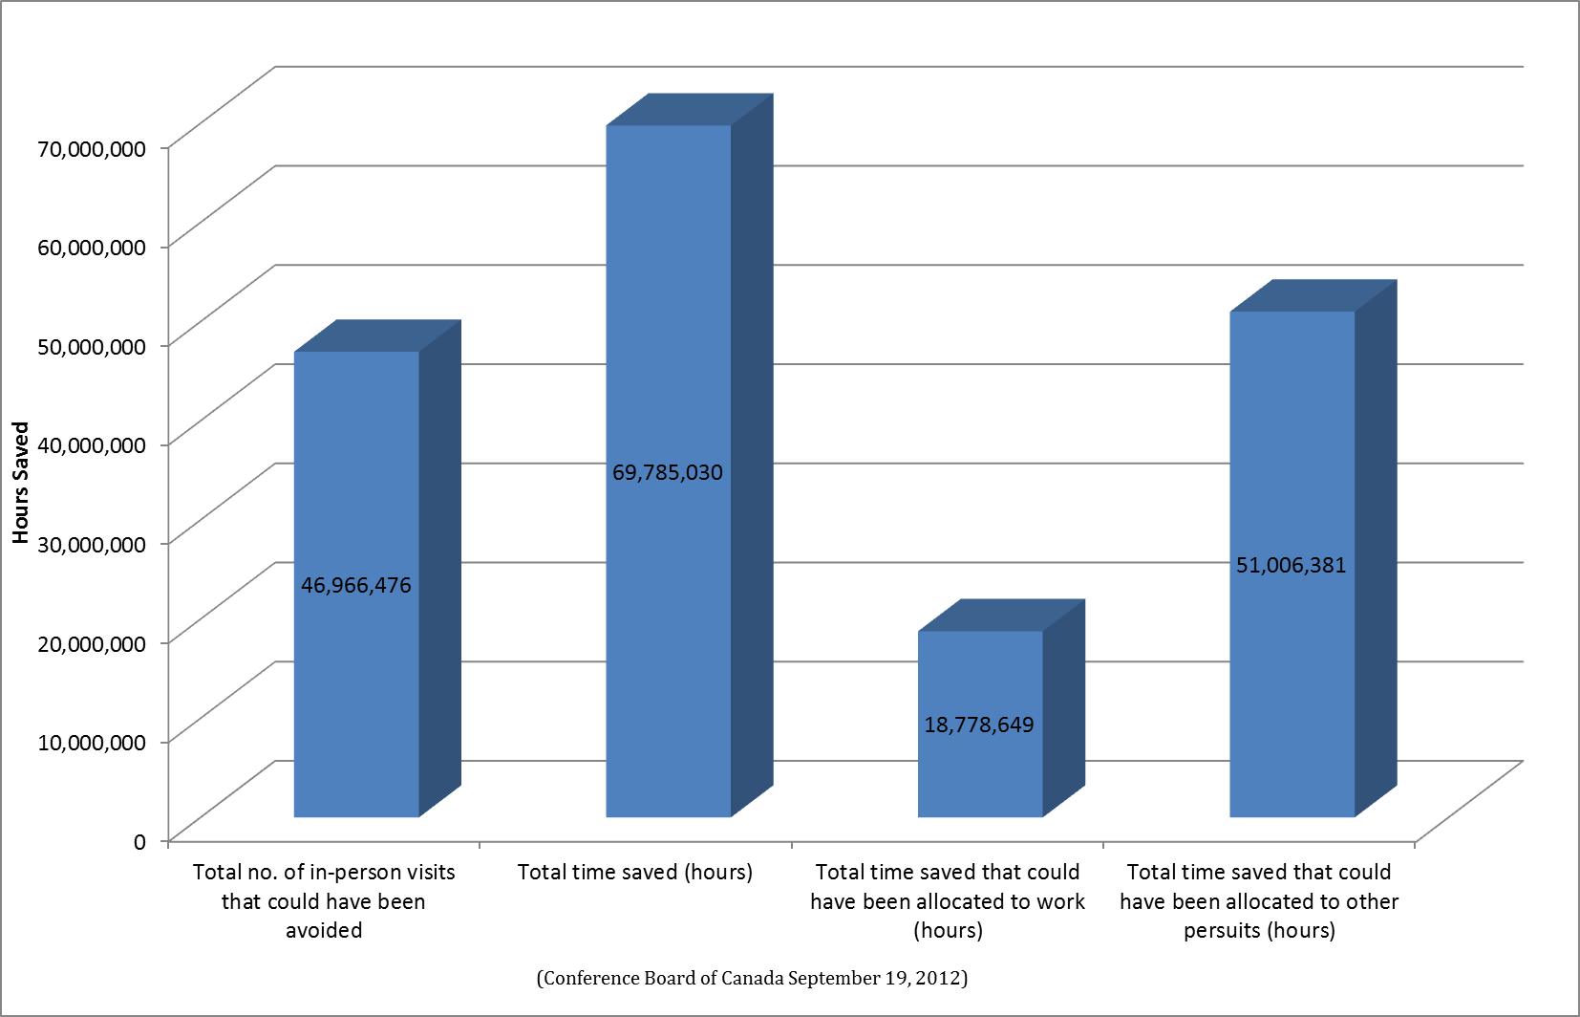
Valuing Time Saved
Slide 36
© Dr. Wendy Graham 2013

Slide 37
Use Case – 4 Year Old with Ear Ache
Parents are awoken at 1 am to their 4 year old crying with otitis media
Doctor appointment is needed, but parents can’t miss a day of work due to circumstances in today’s global economy
A request for a late-afternoon appointment is sent to their Doctor’s office instantly through mihealth’s messaging functionality
The office opens at 9am and reviews messages. Books appointment, and replies with a confirmation
Outcome:
Anxious parents do not repeatedly call-in to book an appointment
Parents do not visit a walk-in clinic
Parents do not miss work
Parents and Doctor’s office complete the steps required for an appointment when the time is most convenient for them
Slide 37
© Dr. Wendy Graham 2013

Slide 38
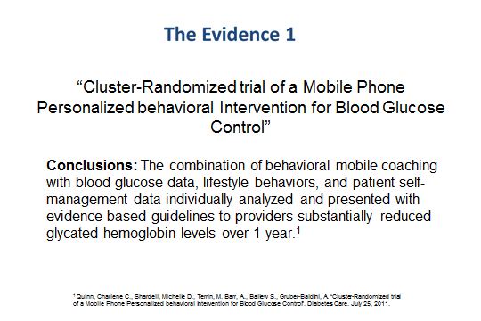
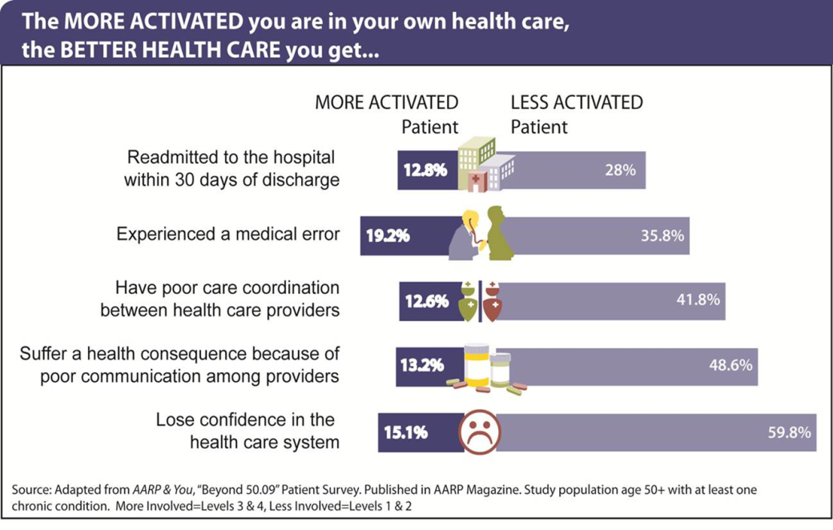
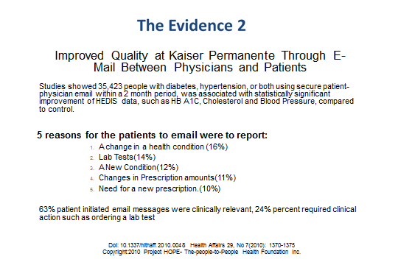
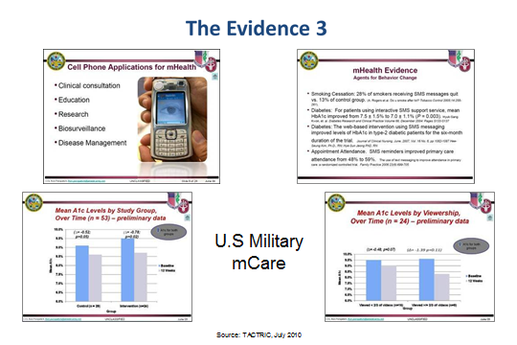
Slide 38
© Dr. Wendy Graham 2013

Slide 39


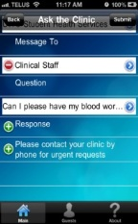
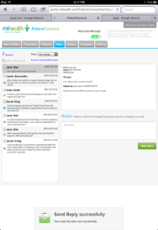



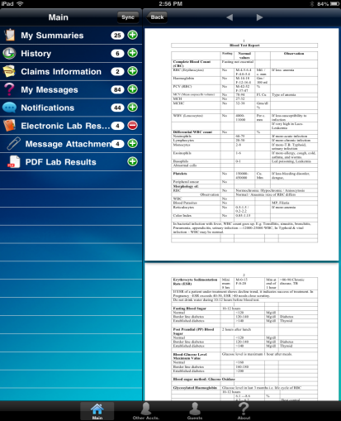
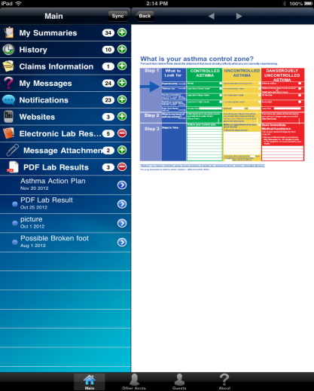
The Mihealth Solution - Point of Care & Real Time
Question: can I please have my blood work?
Response: Please check your PDF documents for your results.
Allows mobile securing messaging and preparation for appointments, tests from anywhere – providing clinics with advance notice of patient requests. Canada Health Infoway Certified. HPPA Compliant and Platinum Security .
With a click of key on 236 MOBILE and TABLET devices message the doctor or clinic . No phone calls. No waiting on hold. No “can’t leave a message”.
All your NEEDED DATA with you available across 236 MOBILE Devices for appointments with the GP or Specialist at point of care for stakeholder or family caregivers
Ongoing case management in real time with mobile to improve out comes and reduce adverse reactions. In a few keystrokes, I had secured an appointment. No phone calls, no waiting on hold.
Patient
Clinical Staff
Slide 39
© Dr. Wendy Graham 2013

Slide 40
Mihealth Value Proposition
The value proposition for the patient is:
  Reduction in unnecessary appointments, wait times, and visits to doctors offices or emergency rooms
  Enhances patient involvement to ensure patient can formulate their individual health care plan
  Improve sharing and coordination among all stakeholders to receive faster care, less waiting, and improved outcomes
  Enhances families ability to become better caregivers for loved ones
  Enhances Mobile/Tablet interoperability improving patient access to information at point of care
The value proposition for the physician is:
  Aging population means increased need for caregiver support
  Time intensive management addressed with secure messaging
  Office efficiency - ROI at 30%
  Improved staff satisfaction and patient outcomes
  Builds patient loyalty, maintains practice size and reduces use of outside services enhancing physician income
  Administrative costs increasing: government audit requirements, EMR/PHR implementation
  Mitigating risk of metadata
Slide 40
© Dr. Wendy Graham 2013

Slide 41
The NEED as expressed by a Patient
Dear Dr. Graham:
I am happy to document for you and others an aspect of my experience with our healthcare system that is both frustrating and deserves improvement, an improvement that will result in improved quality and a reduction in unnecessary care as a result of duplication. This frustration concerns the lack of tools I have at my disposal to better self-manage my chronic disease while ensuring an effective and efficient use of health information.
Yours sincerely,
Bernard Lamontagne
Bernard Lamontagne, RFACHE, FCCHL, MBA
P/S: As a staff of a LHIN, I understand the importance to foster the use of a secure, efficient and reliable electronic communication tool especially for the use by our local population that have one or more chronic conditions to manage.
Slide 41
© Dr. Wendy Graham 2013

Slide 42
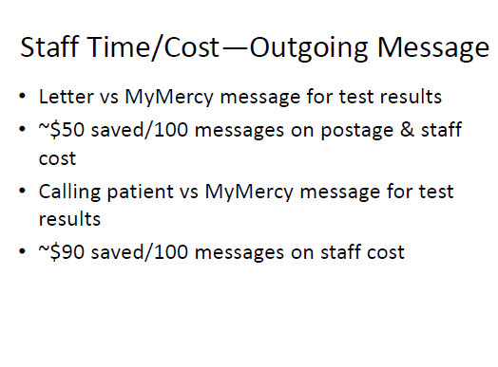
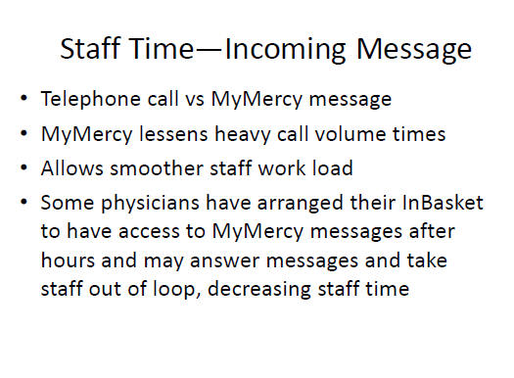
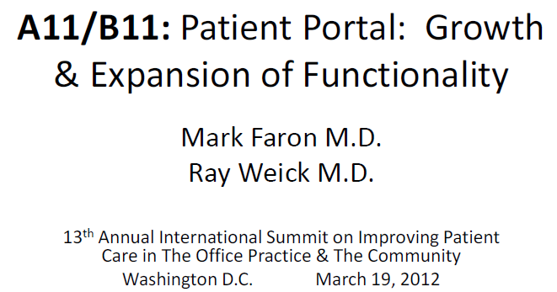
These Were Key Learning Lessons…
MyMercy is a Secure Messaging Service in the US
Return on Investment
Source:
Slide 42
© Dr. Wendy Graham 2013

Slide 43
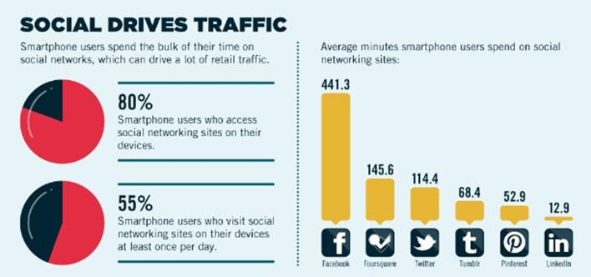
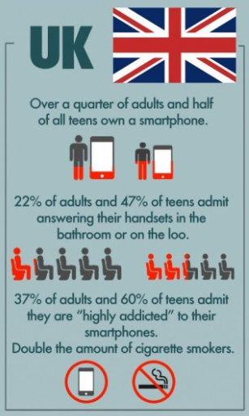

Social Media Drives Traffic to Local Direction
Source:
Source: So Mobile
Slide 43
© Dr. Wendy Graham 2013

Slide 44
Impact of text and email messaging on the sexual health of young people: A randomized controlled trial
Published Online First 17 March 2011
There were 994 people aged 16-29 recruited at a music festival to a non-blinded randomised controlled trial over 12 months. They used catchy sexual prevention slogans.
Conclusion This simple intervention improved STI knowledge in both sexes and STI testing in women, but had no impact on condom use. SMS and email are low cost, popular and convenient, and have considerable potential for health promotion.
Slide 44
© Dr. Wendy Graham 2013

Slide 45


Slide 45
© Dr. Wendy Graham 2013

Slide 46


Emerging Privacy Concerns
Slide 46
© Dr. Wendy Graham 2013

Slide 47


Emerging Privacy Concerns
Slide 47
© Dr. Wendy Graham 2013

Slide 48
Health Links – The Ontario Govt’s Vision
Collaboration - Health Links encourages the idea of collaboration and coordination amongst health care providers to support patients at all levels of the health system.
Involving all Stakeholders - Involves all stakeholders (family care providers, specialists, hospitals, long-term care, home care and other community supports) in patient care.
Patient Involvement - Health Links will work closely with patients, so that health care providers can formulate an individualized plan, and ensure the plan is being followed.
Information/Resource Sharing - Health Links will facilitate information sharing and improved coordination amongst stakeholders, which will allow patients to receive faster care and spend less time waiting.
Outcomes Measurements - Health Links will measure results and develop plans to improve access to family care, reduce avoidable emergency room visits, reduce hospital re-admissions, etc.
Other - Health Links aims to manage patients with complex chronic disease using a comprehensive, integrated, easy to navigate, and collaborative approach across the entire health care system.
Slide 48
© Dr. Wendy Graham 2013

Slide 49

Thank You!
You can visit our website at www.mihealth.com to find out more information
You can also contact me personally at:
  Office: 1-855-341-4040
  Email: drwendy.graham@mihealth.com
Slide 49
© Dr. Wendy Graham 2013

